Slide 1

Cover
Notes:
textbox
No alt text provided
textbox
No alt text provided
image
No alt text provided
shape
No alt text provided
shape
No alt text provided
textbox
No alt text provided

Slide 2
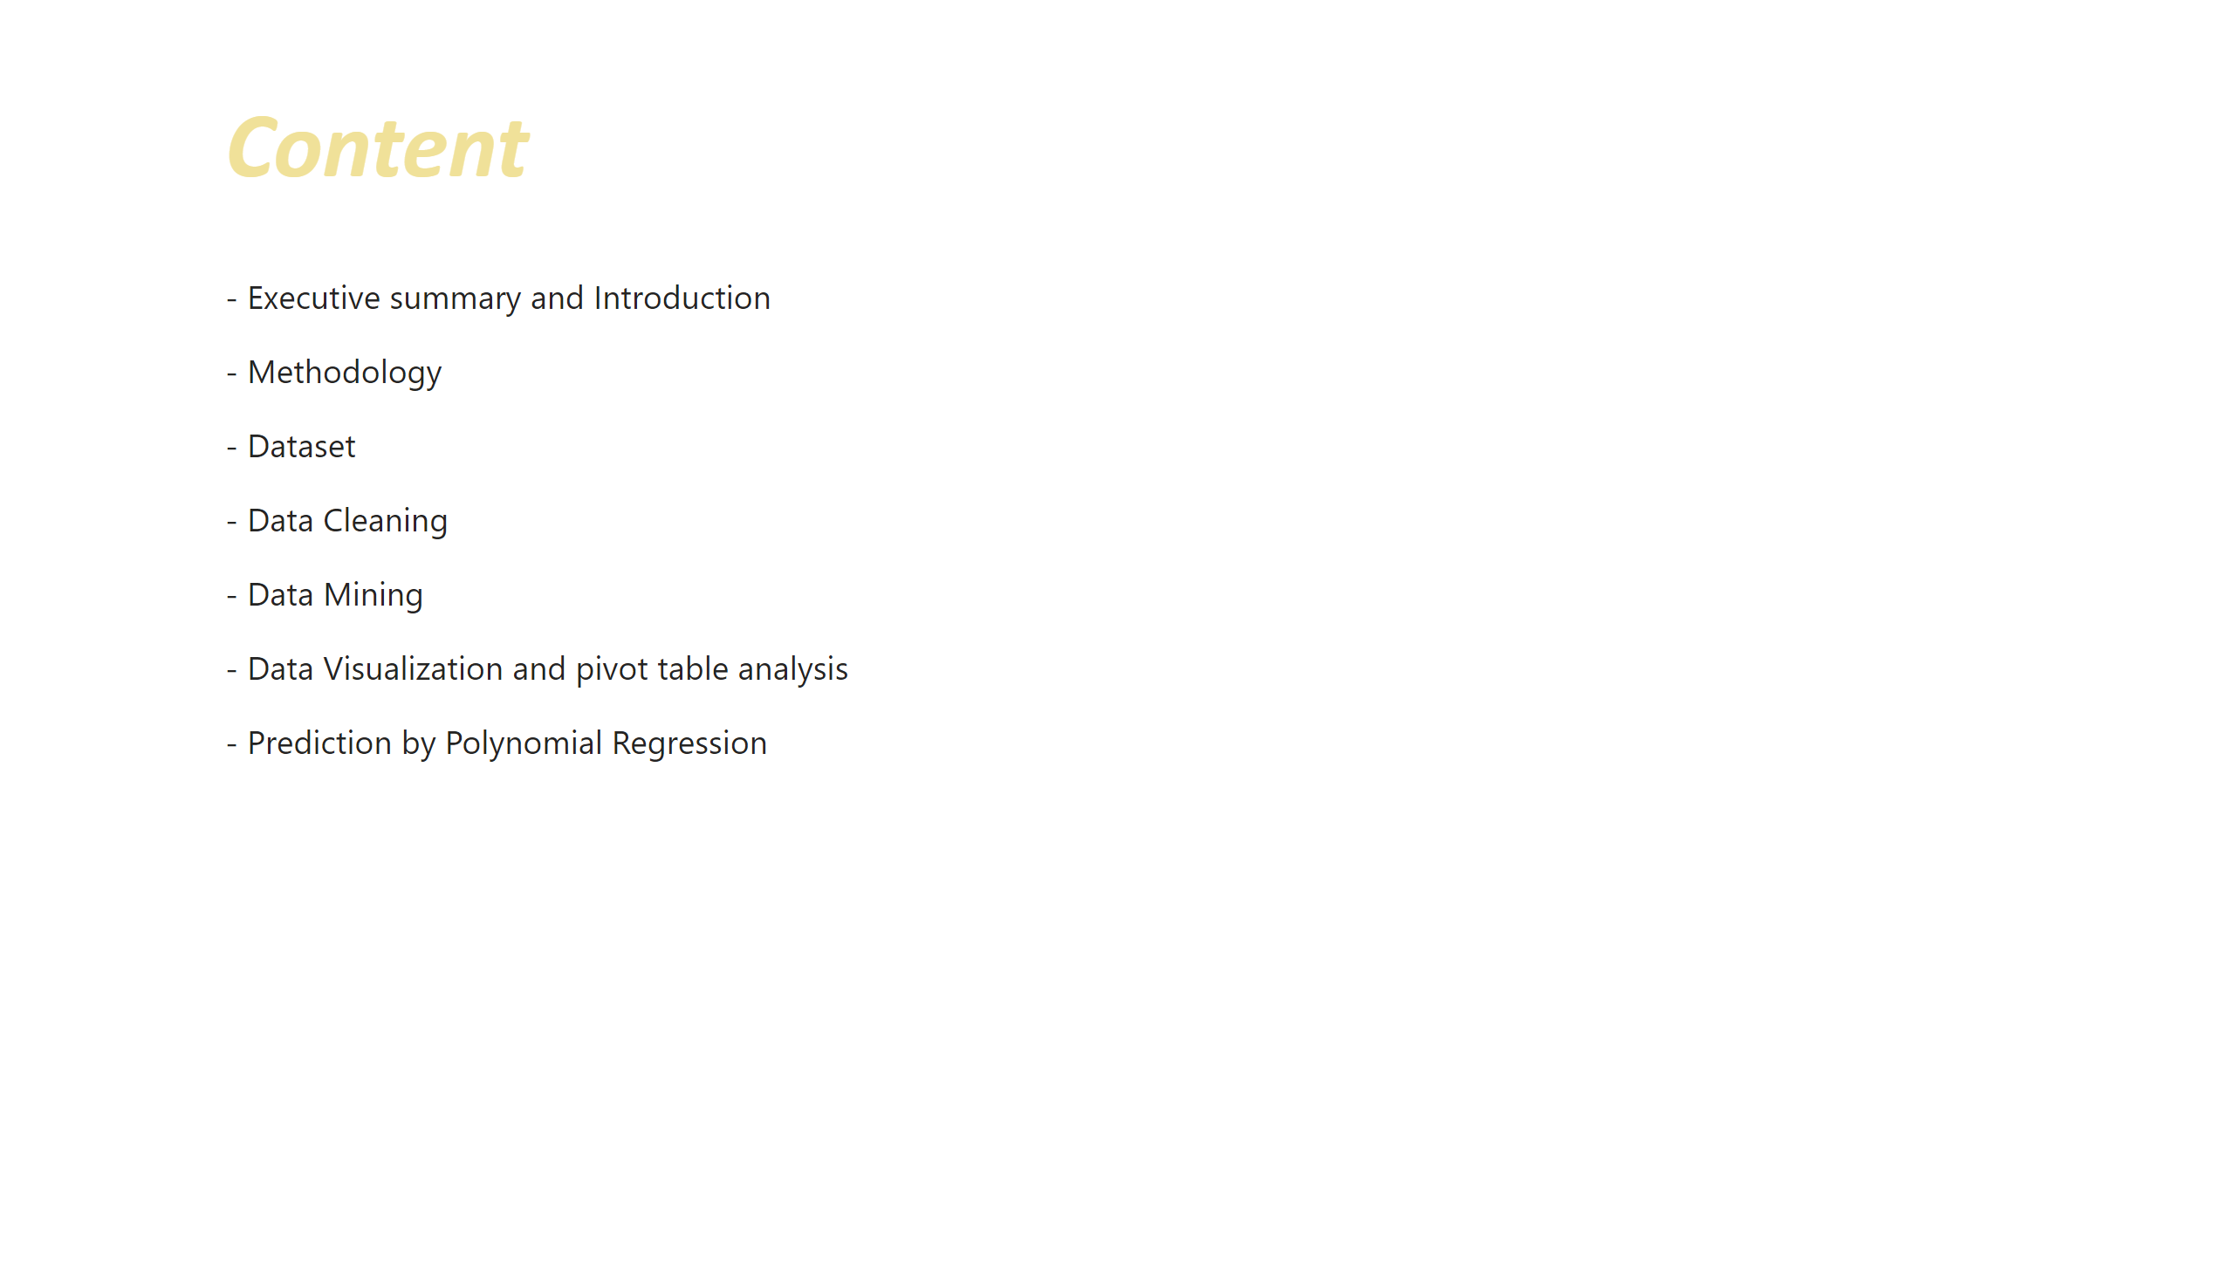
Content
Notes:
textbox
No alt text provided
textbox
No alt text provided

Slide 3
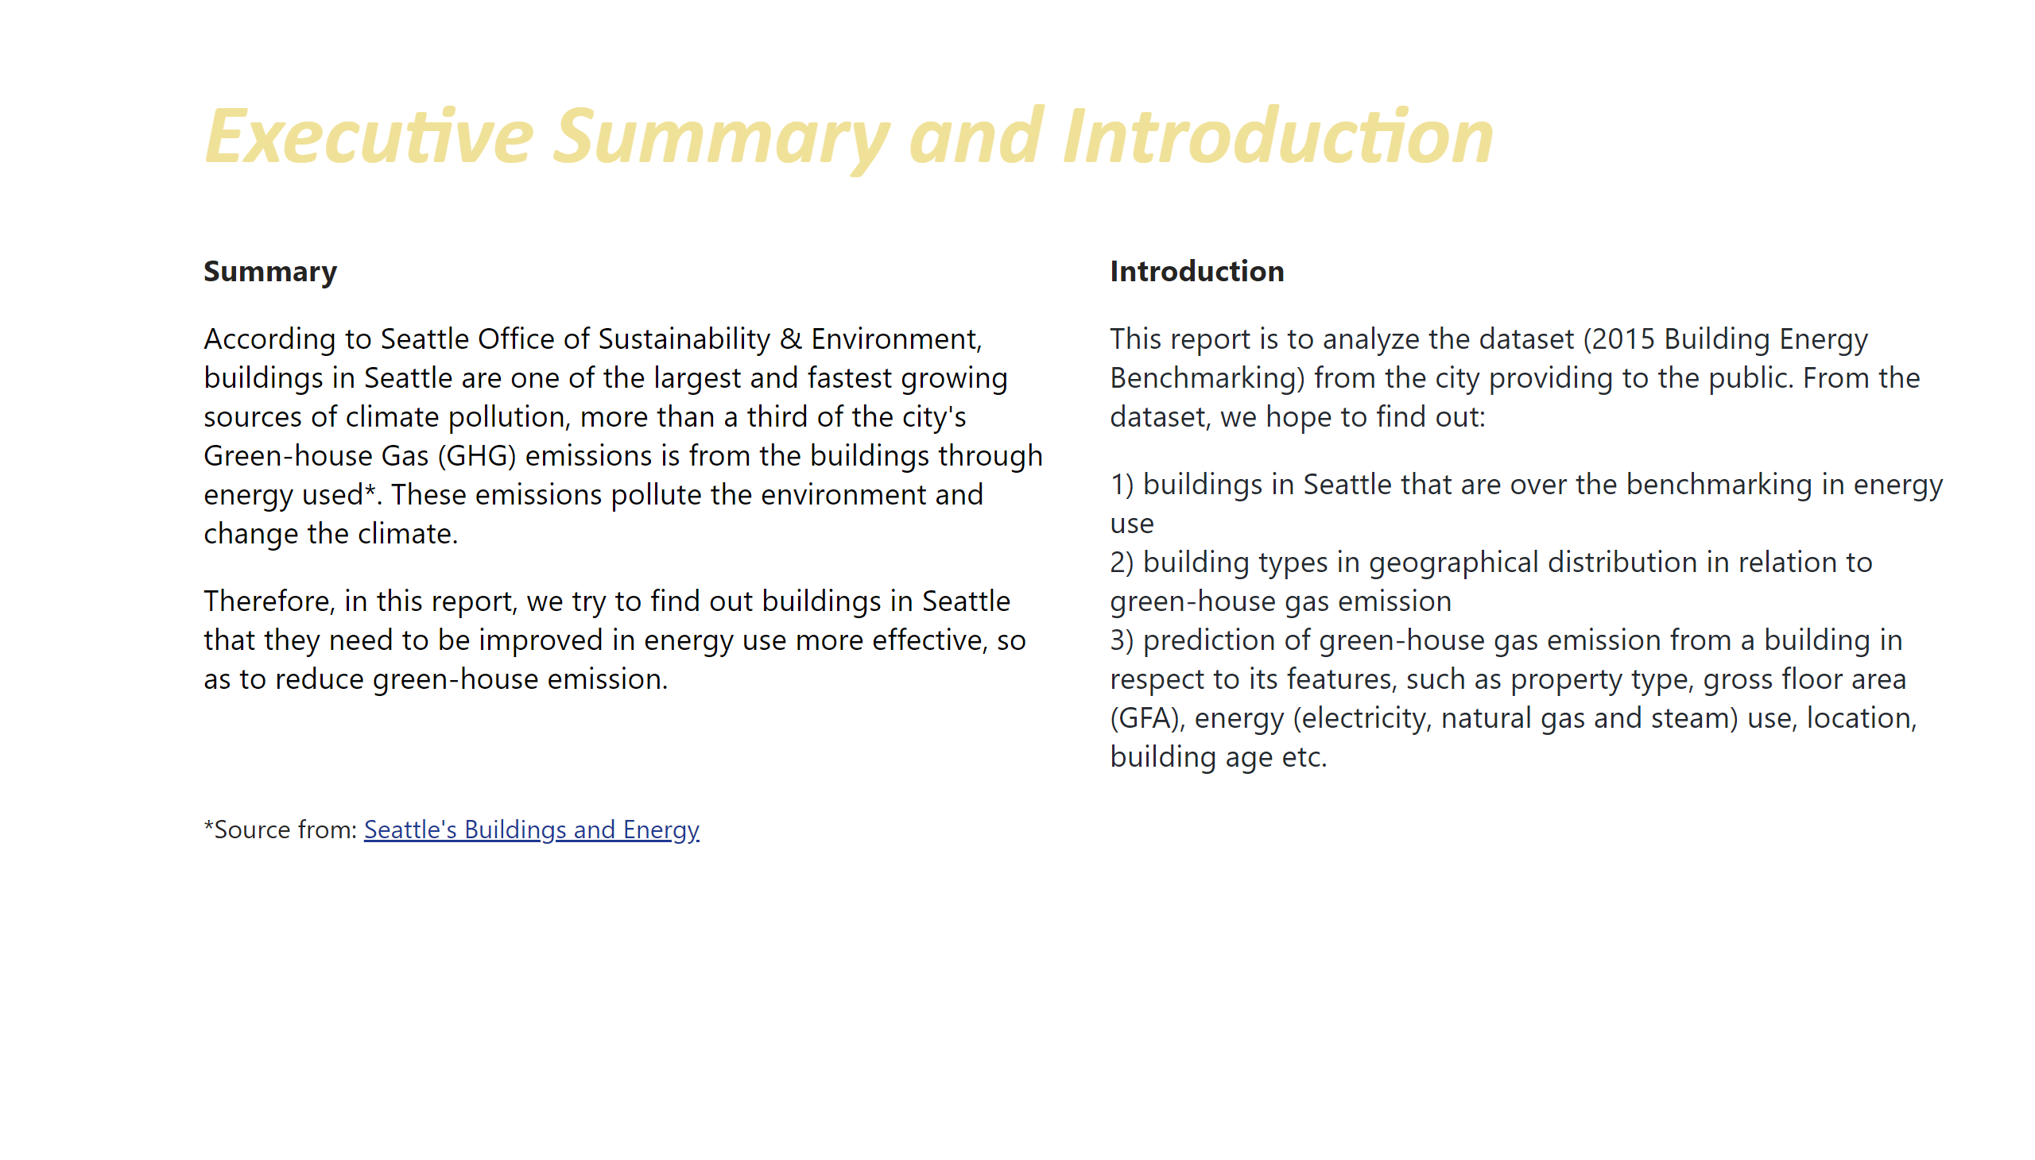
Intro
Notes:
textbox
No alt text provided
textbox
No alt text provided
textbox
No alt text provided

Slide 4
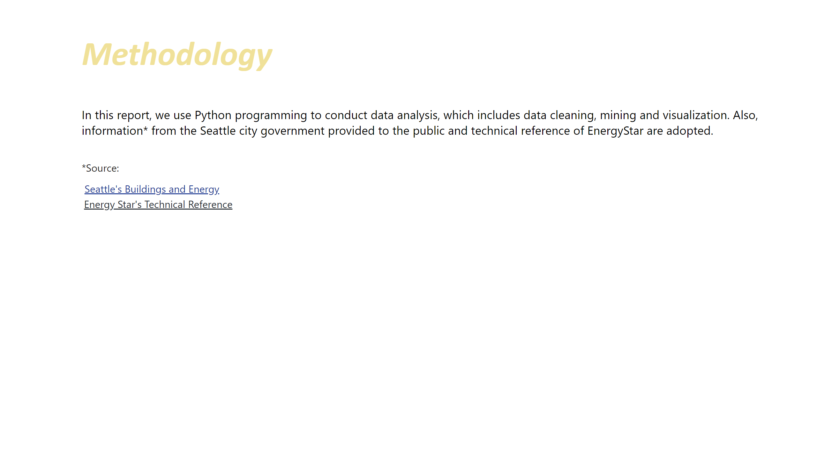
Methodology
Notes:
textbox
No alt text provided
textbox
No alt text provided

Slide 5
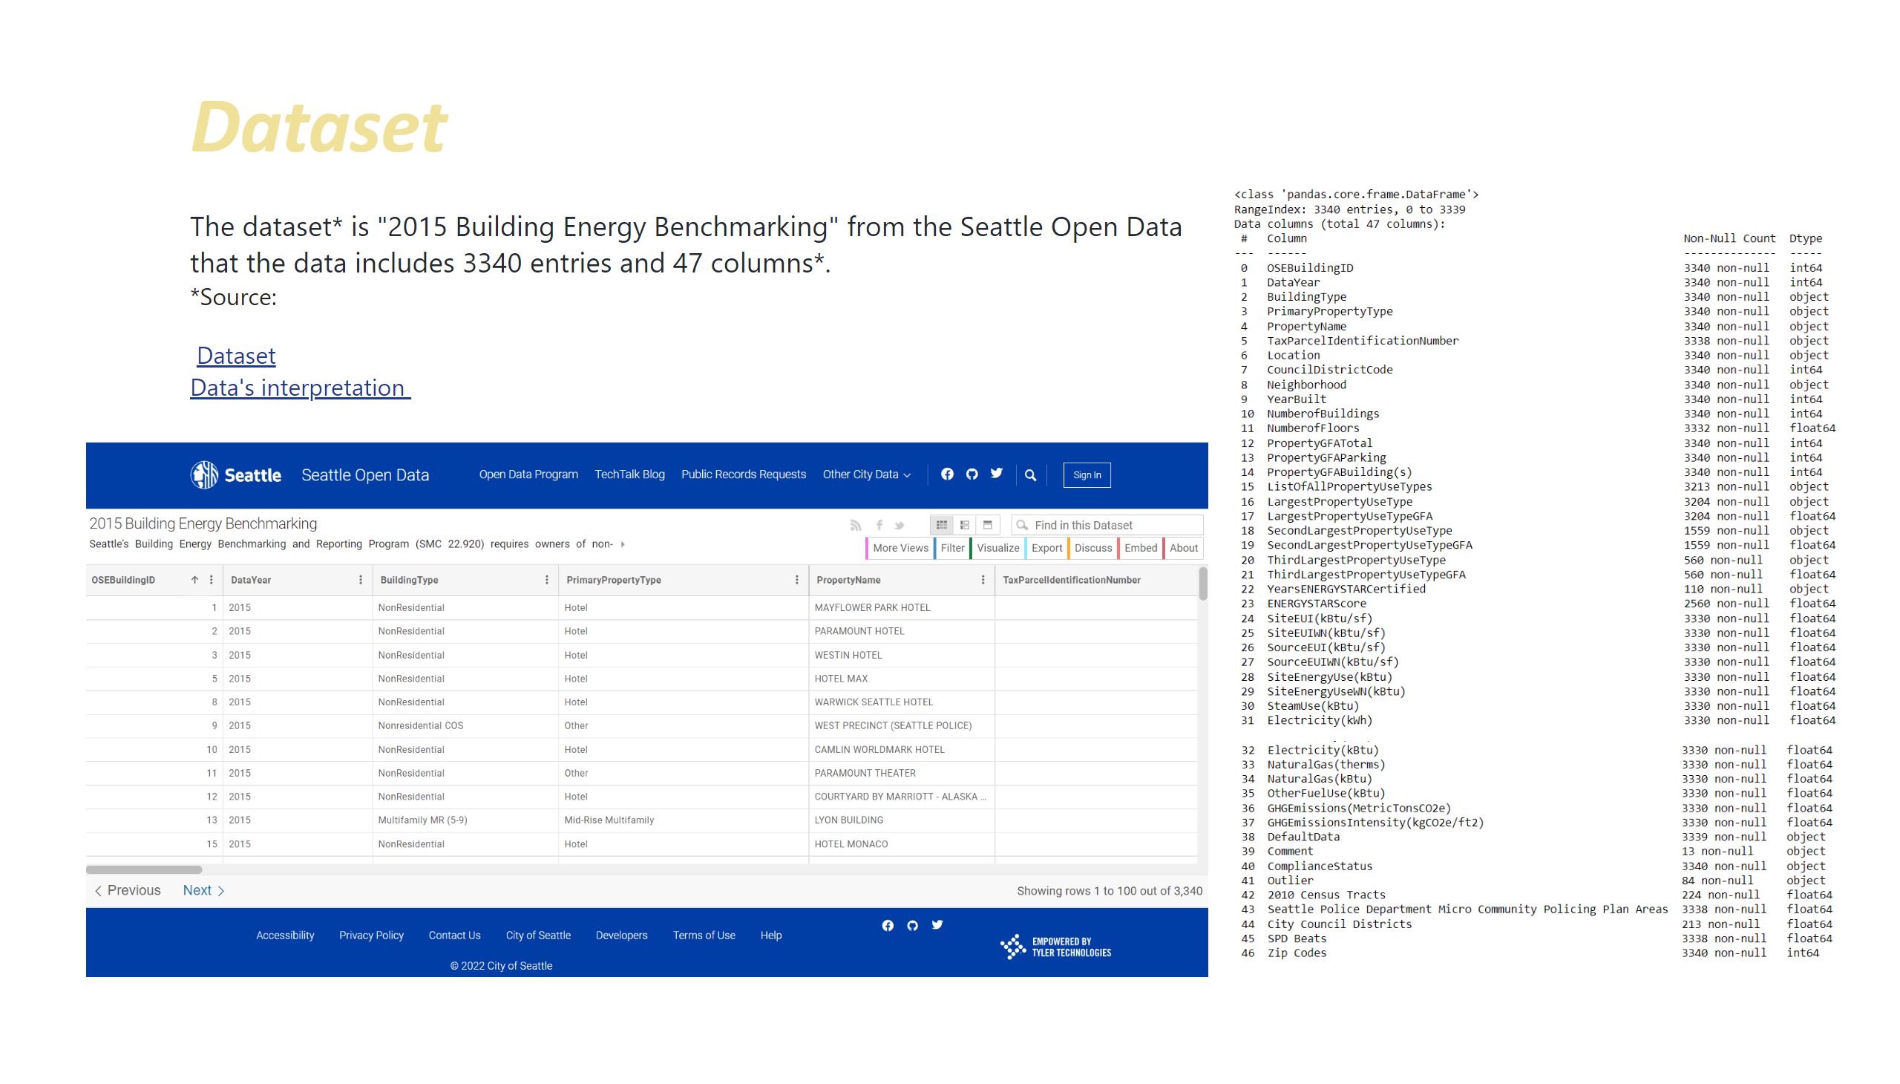
Dataset
Notes:
textbox
No alt text provided
textbox
No alt text provided
image
No alt text provided
image
No alt text provided
image
No alt text provided

Slide 6
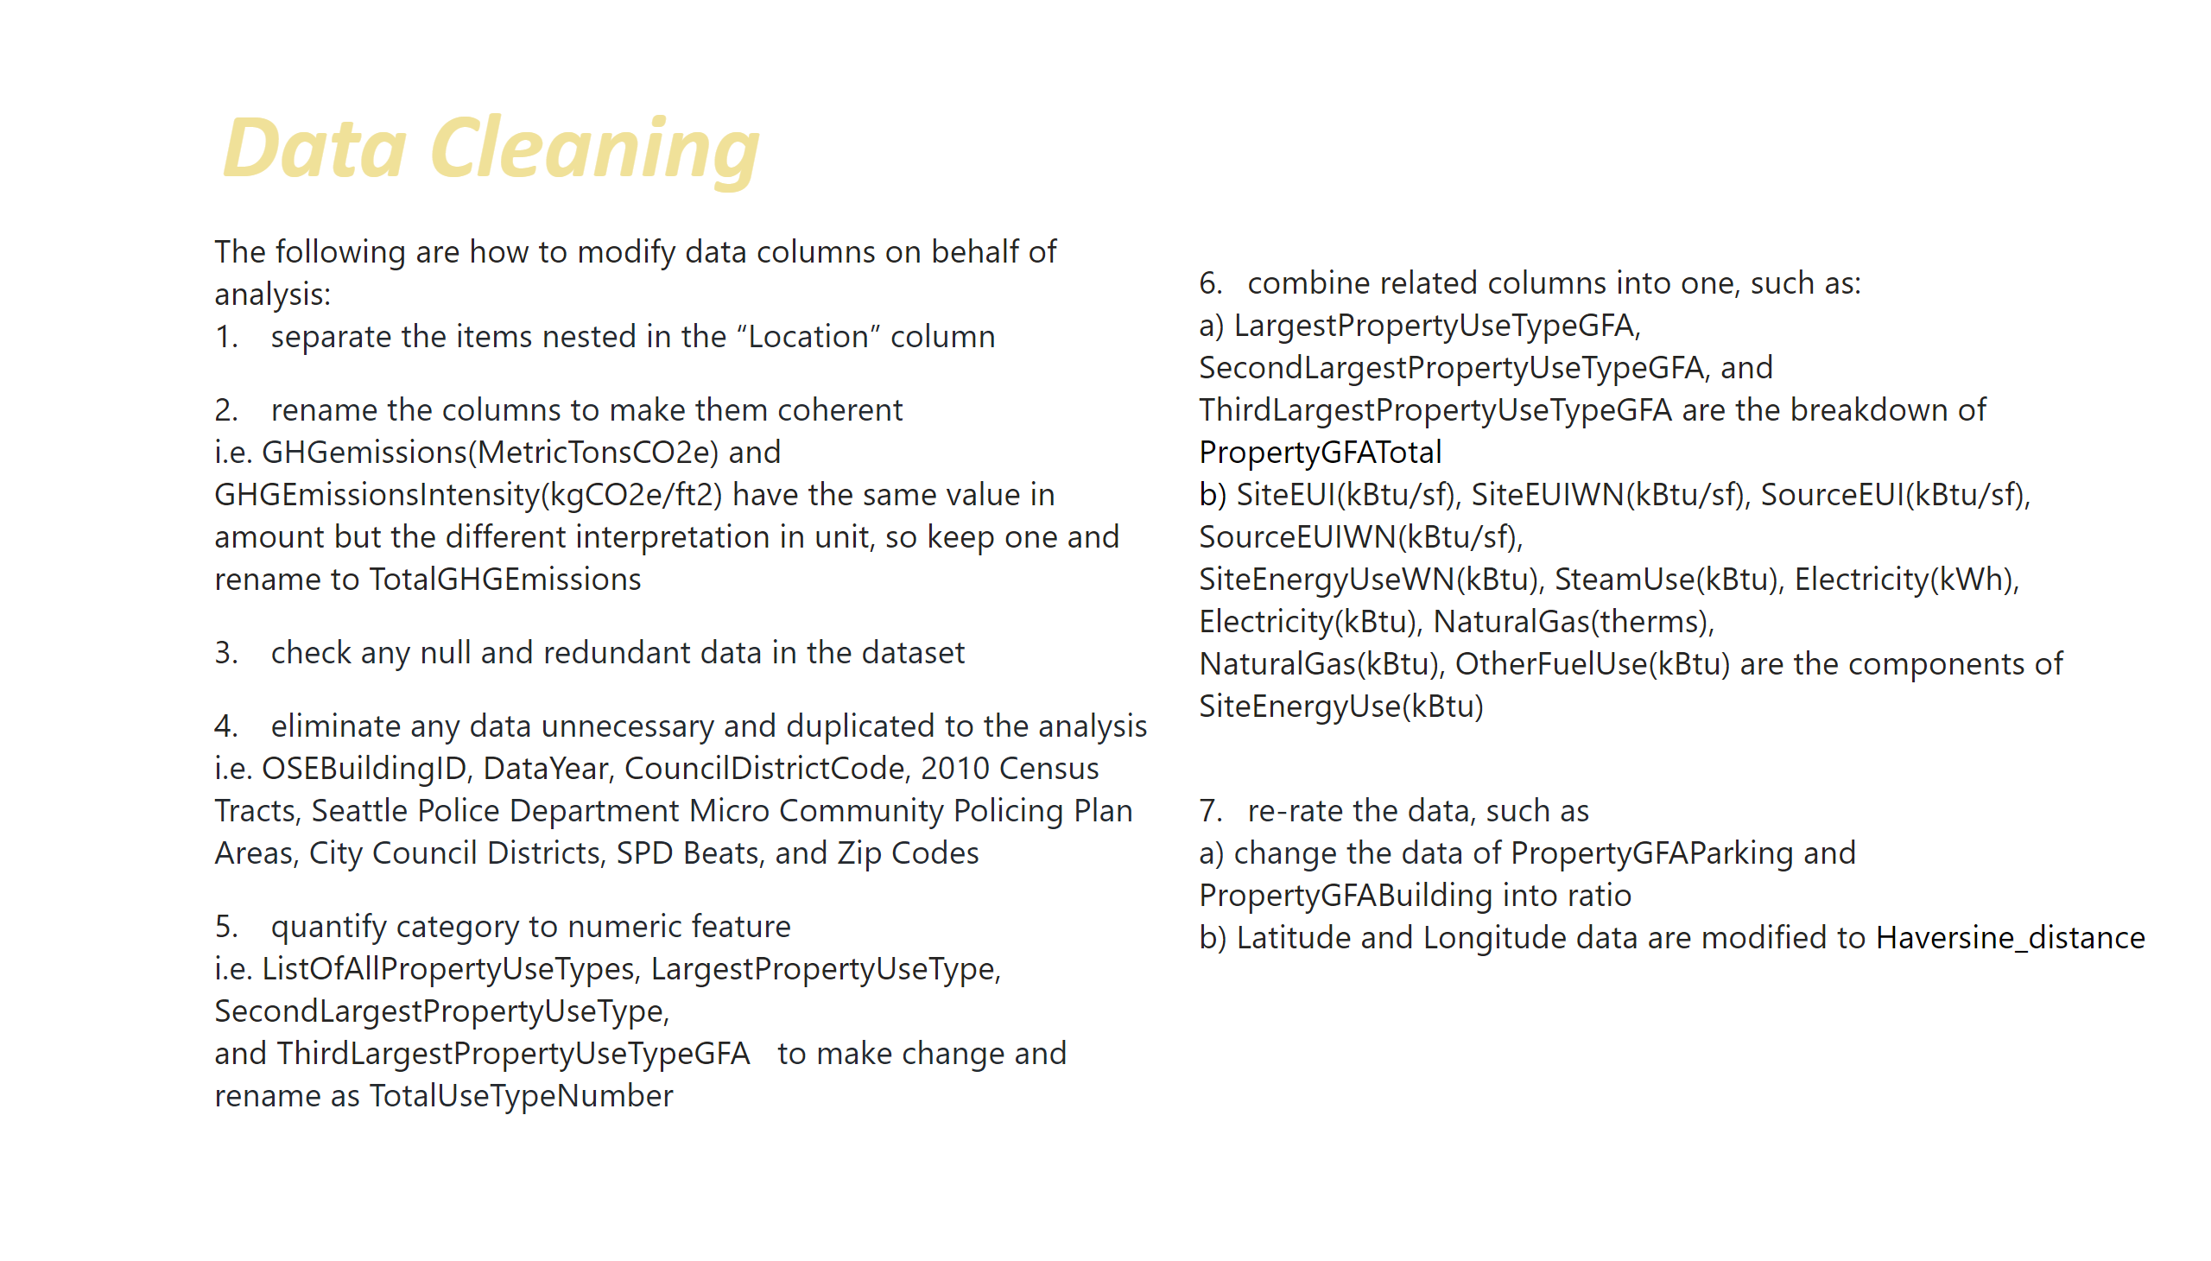
Data Cleaning
Notes:
textbox
No alt text provided
textbox
No alt text provided
textbox
No alt text provided

Slide 7
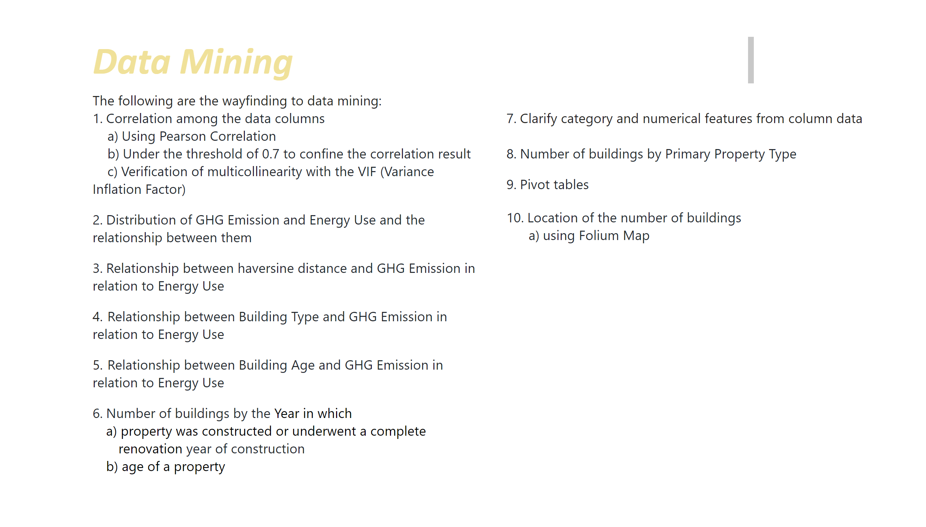
Data Mining
Notes:
textbox
No alt text provided
textbox
No alt text provided
textbox
No alt text provided

Slide 8
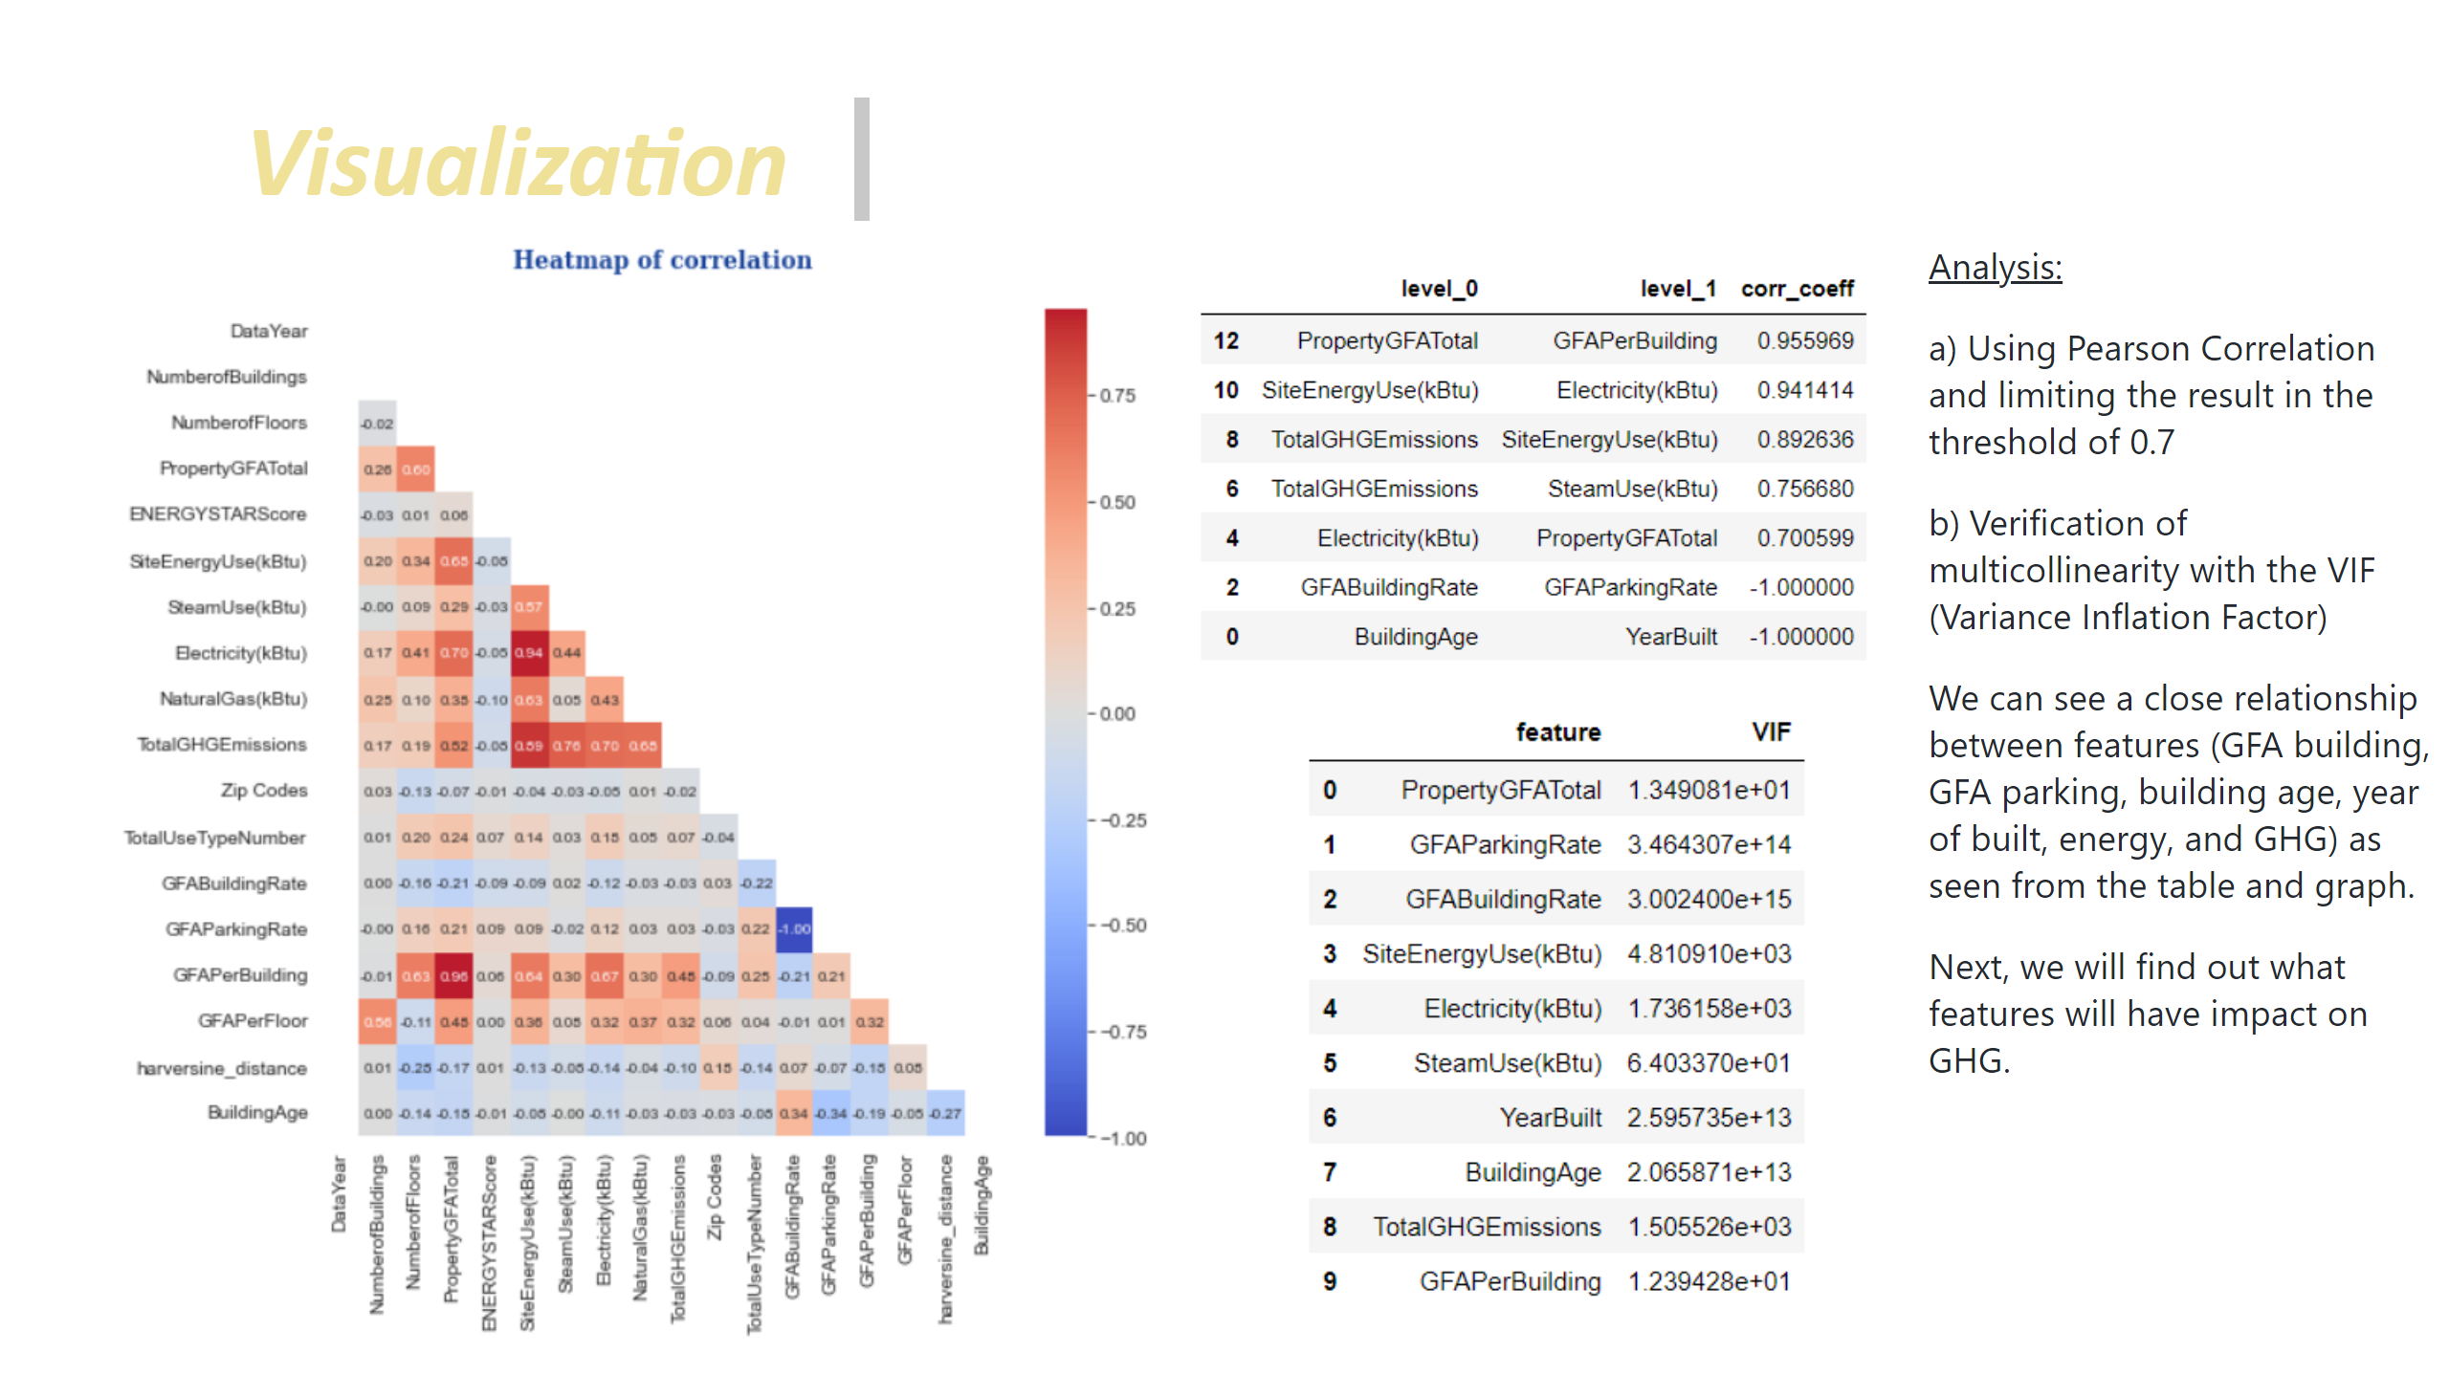
Visualization_1
Notes:
textbox
No alt text provided
image
No alt text provided
image
No alt text provided
image
No alt text provided
textbox
No alt text provided

Slide 9
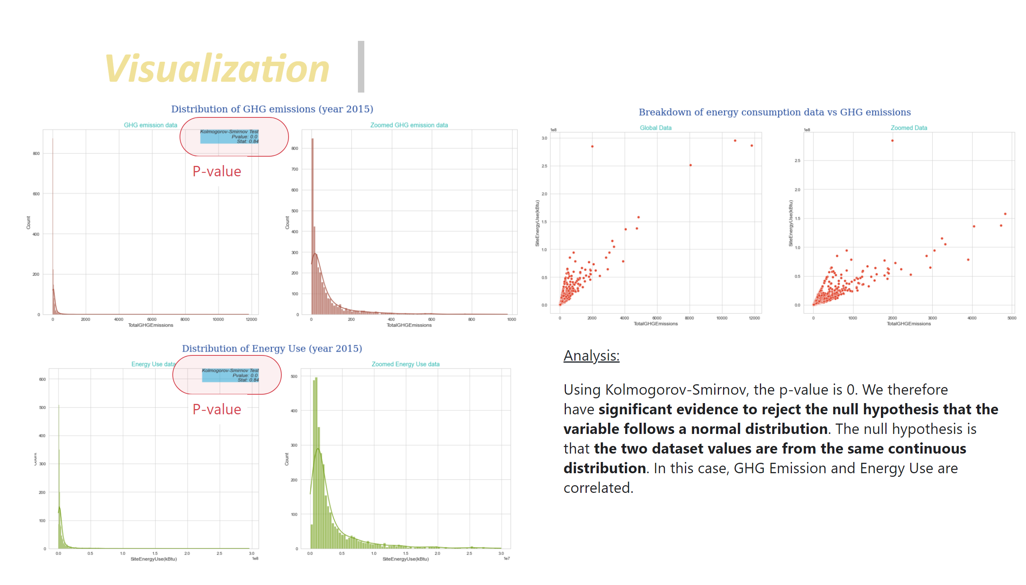
Visualization_2
Notes:
textbox
No alt text provided
image
No alt text provided
image
No alt text provided
textbox
No alt text provided
image
No alt text provided
shape
No alt text provided
shape
No alt text provided
textbox
No alt text provided
textbox
No alt text provided

Slide 10
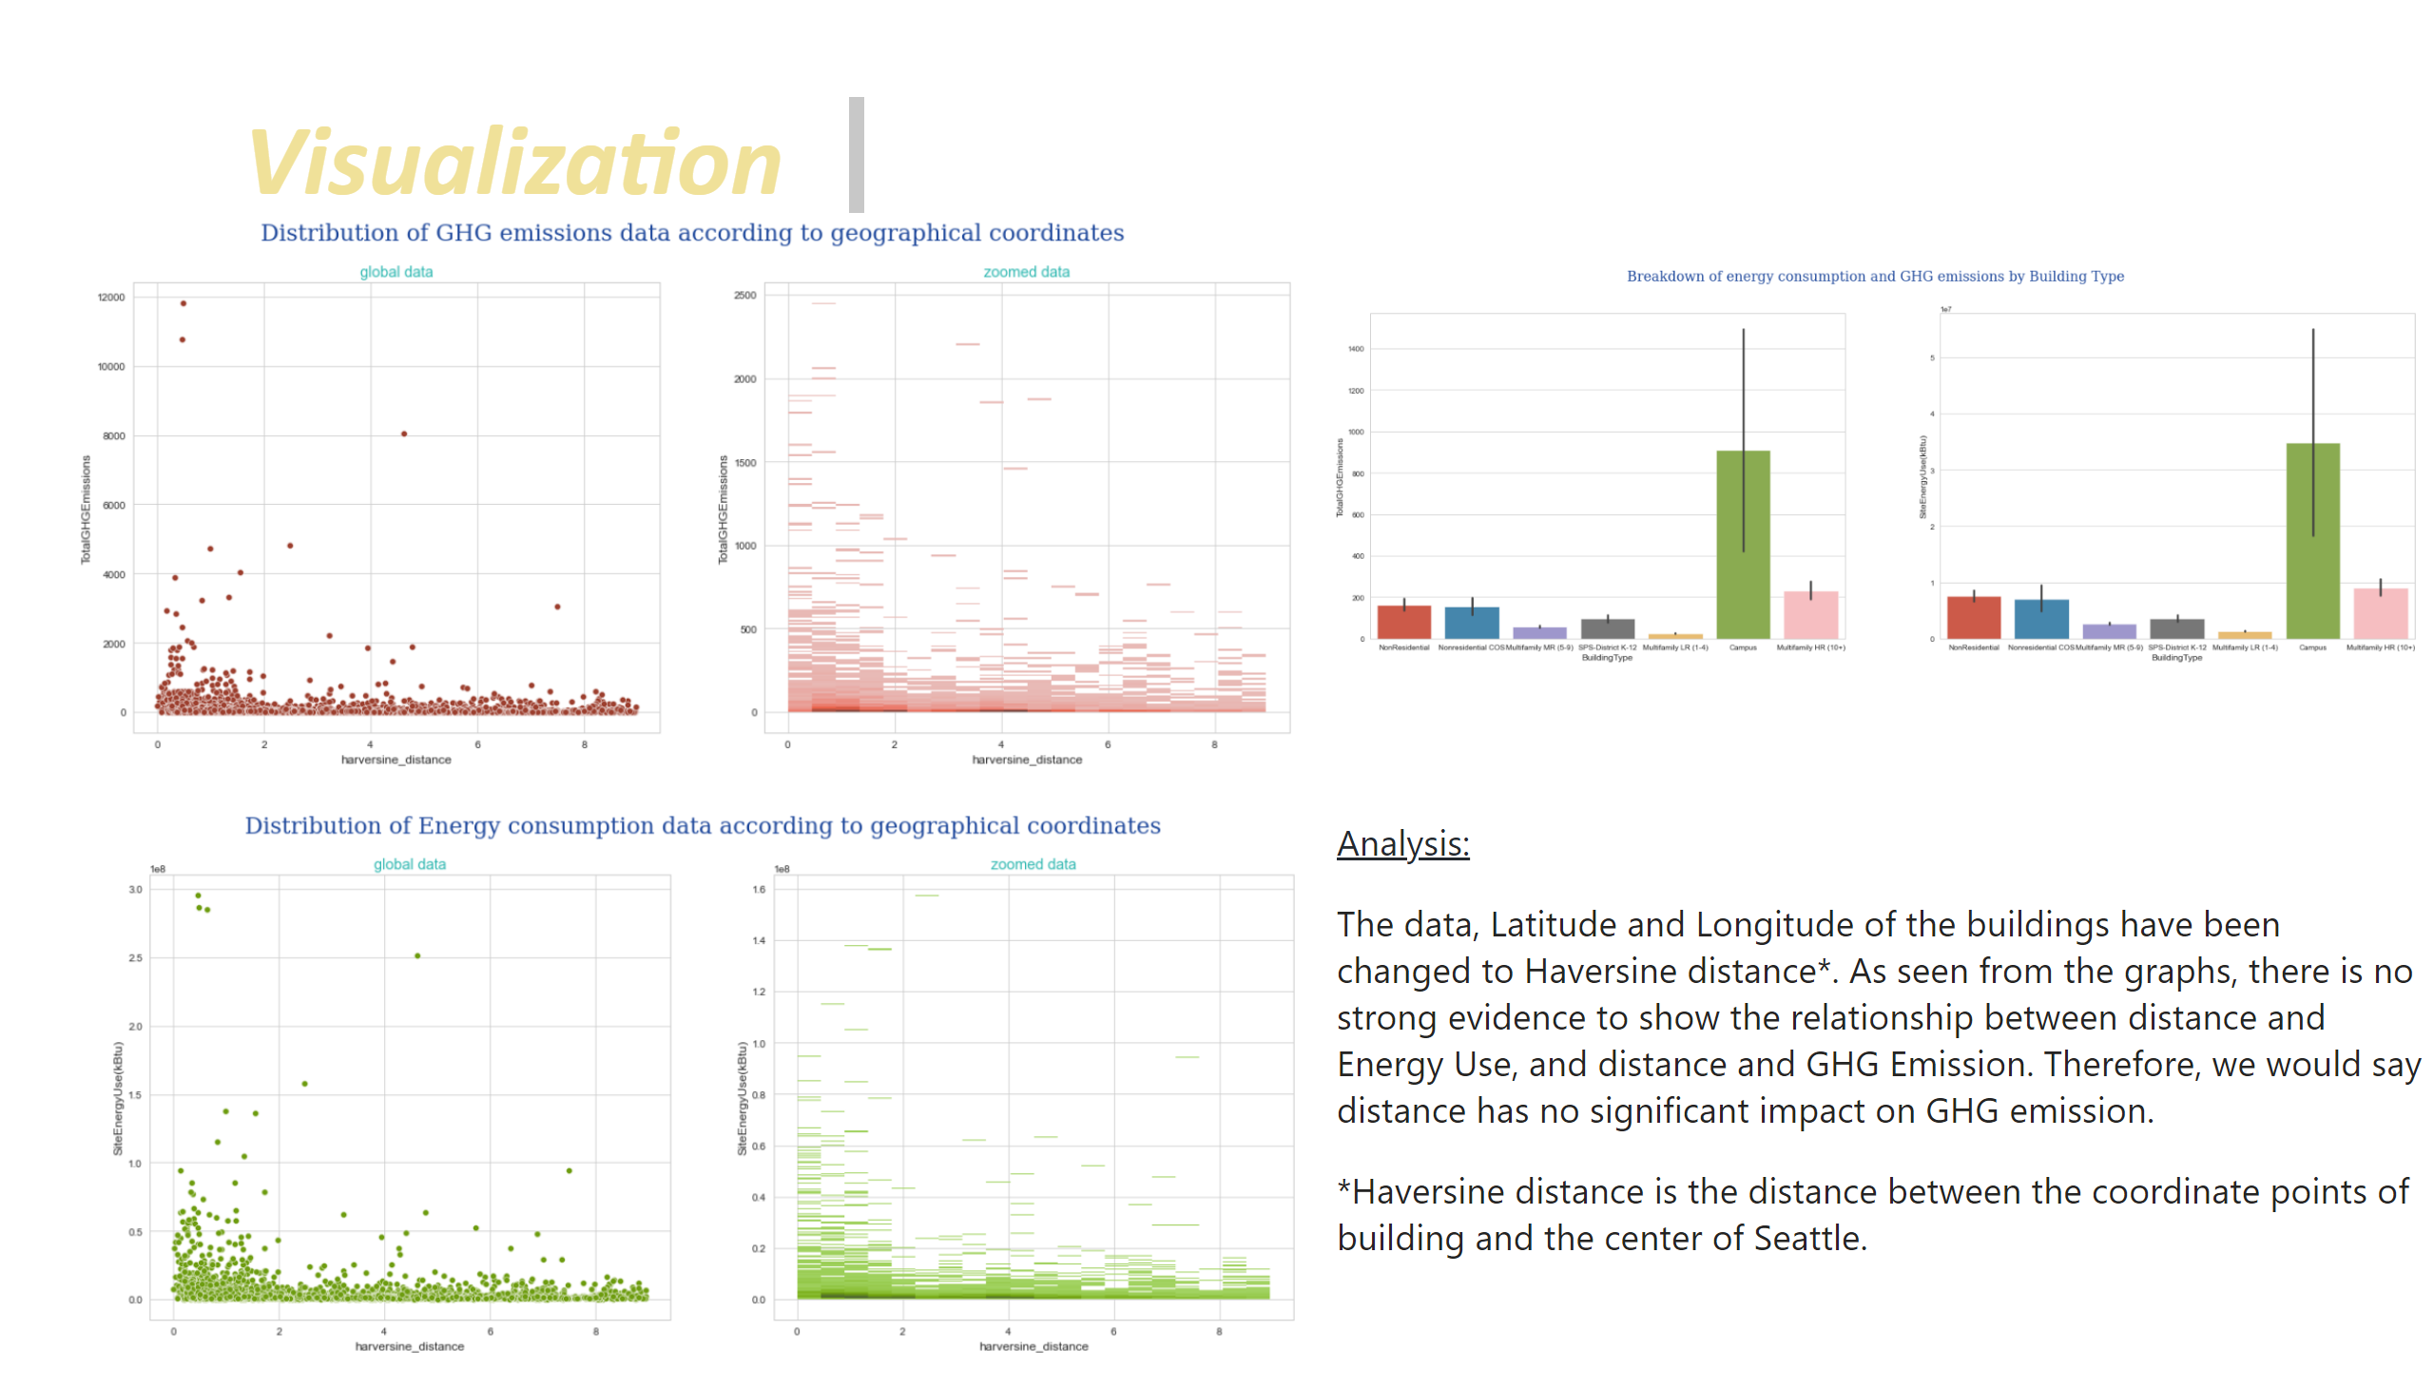
Visualization_3
Notes:
textbox
No alt text provided
image
No alt text provided
image
No alt text provided
image
No alt text provided
textbox
No alt text provided

Slide 11
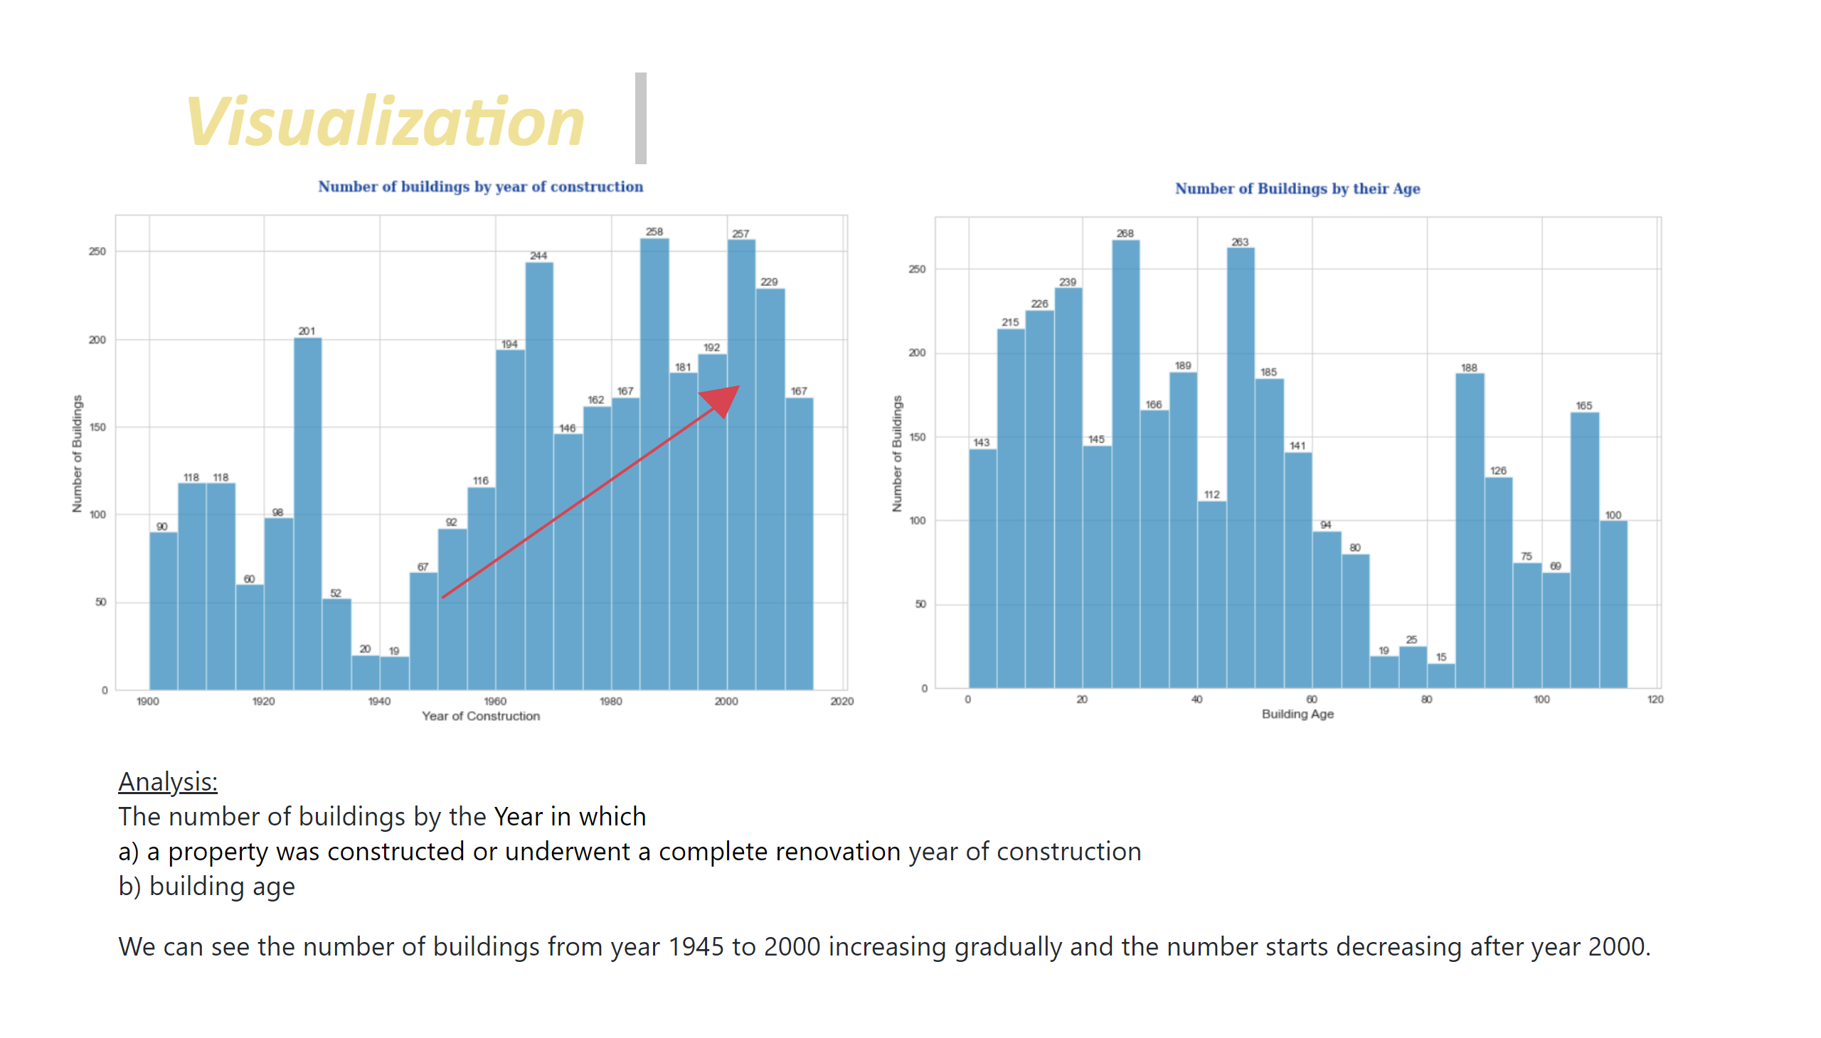
Visualization_4
Notes:
textbox
No alt text provided
image
No alt text provided
image
No alt text provided
textbox
No alt text provided
shape
No alt text provided
shape
No alt text provided

Slide 12
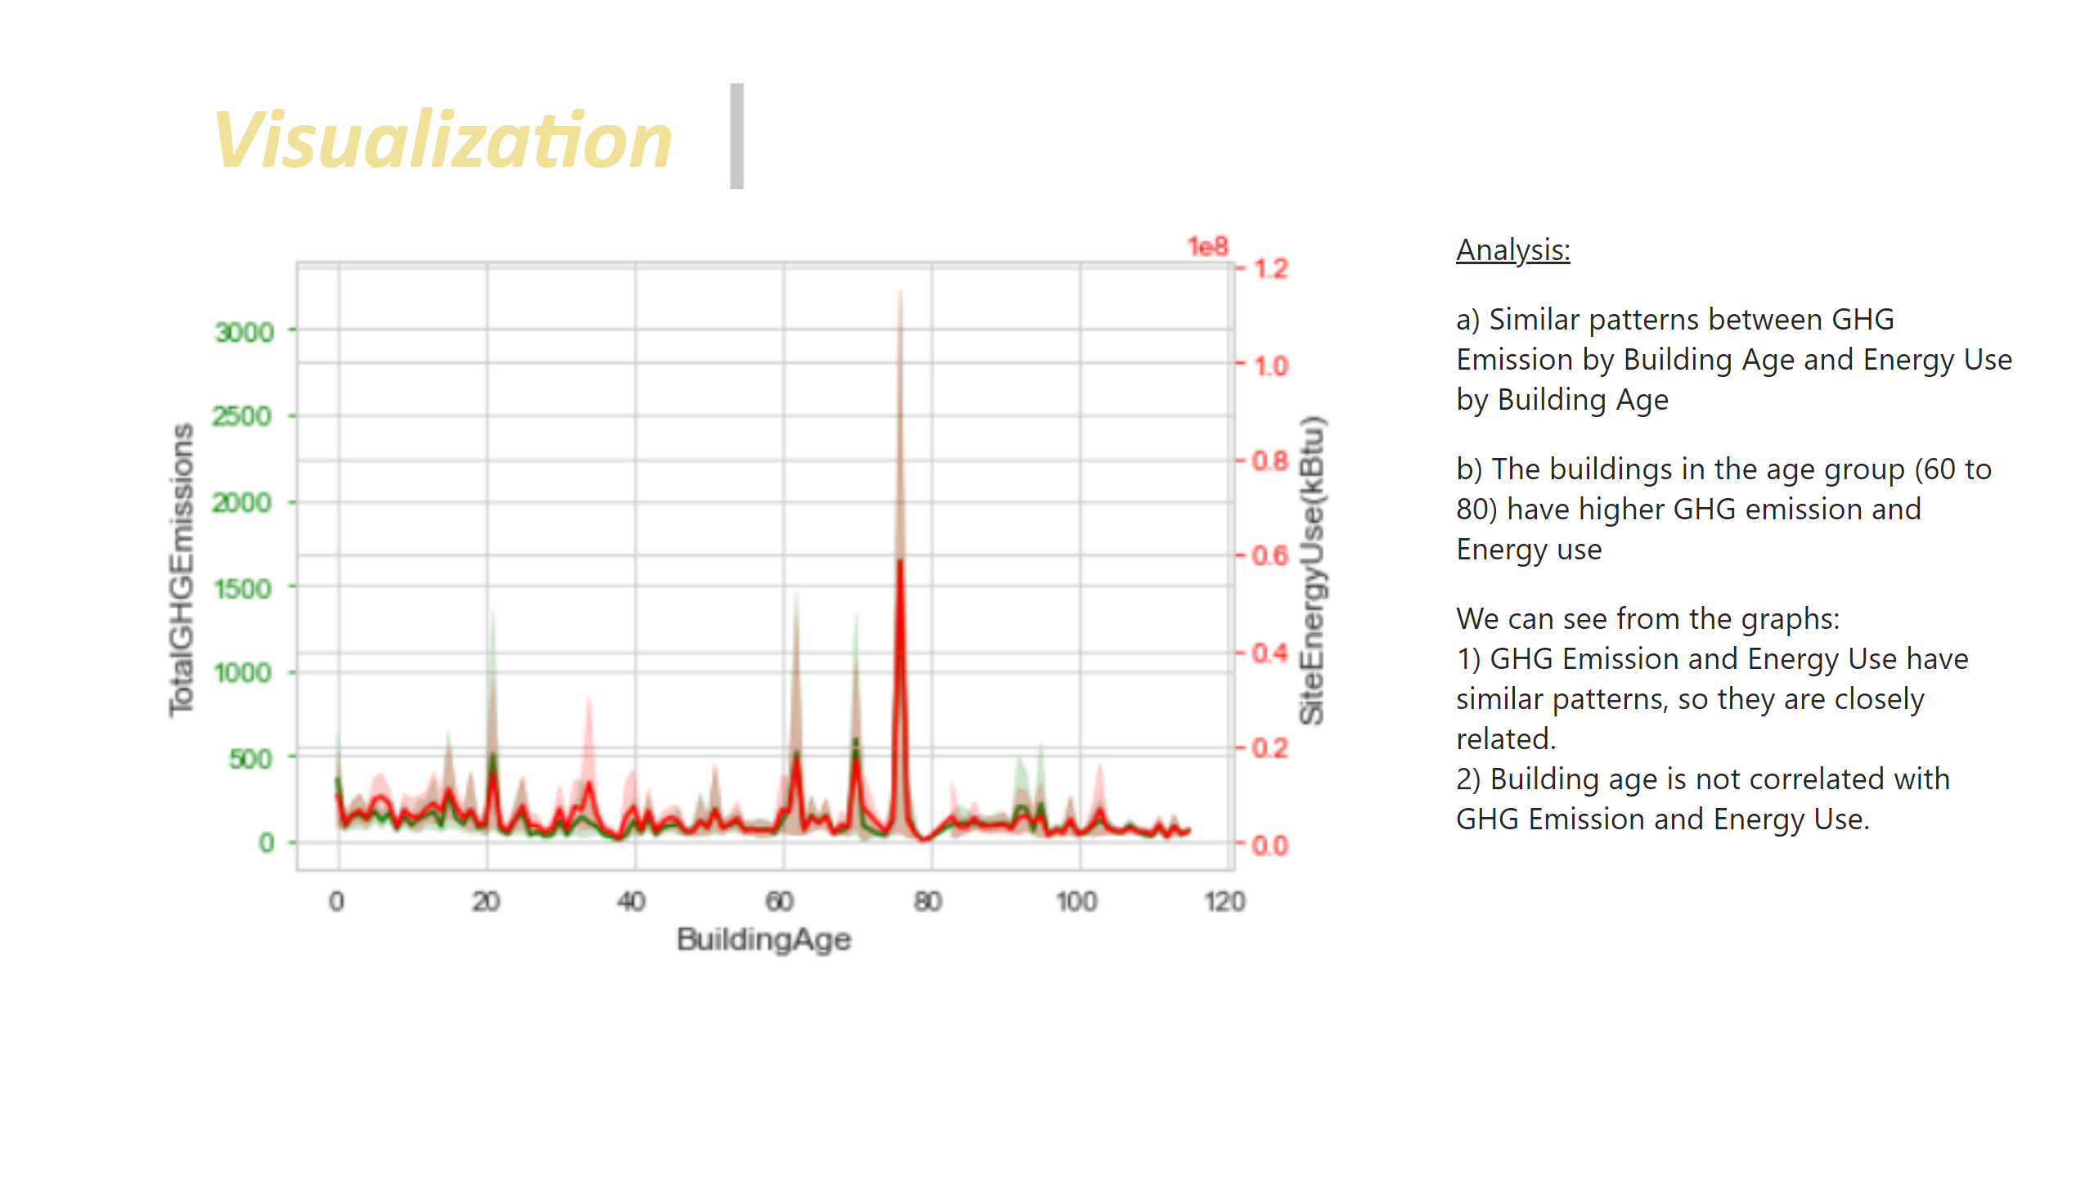
Visualization_4a
Notes:
textbox
No alt text provided
textbox
No alt text provided
image
No alt text provided

Slide 13
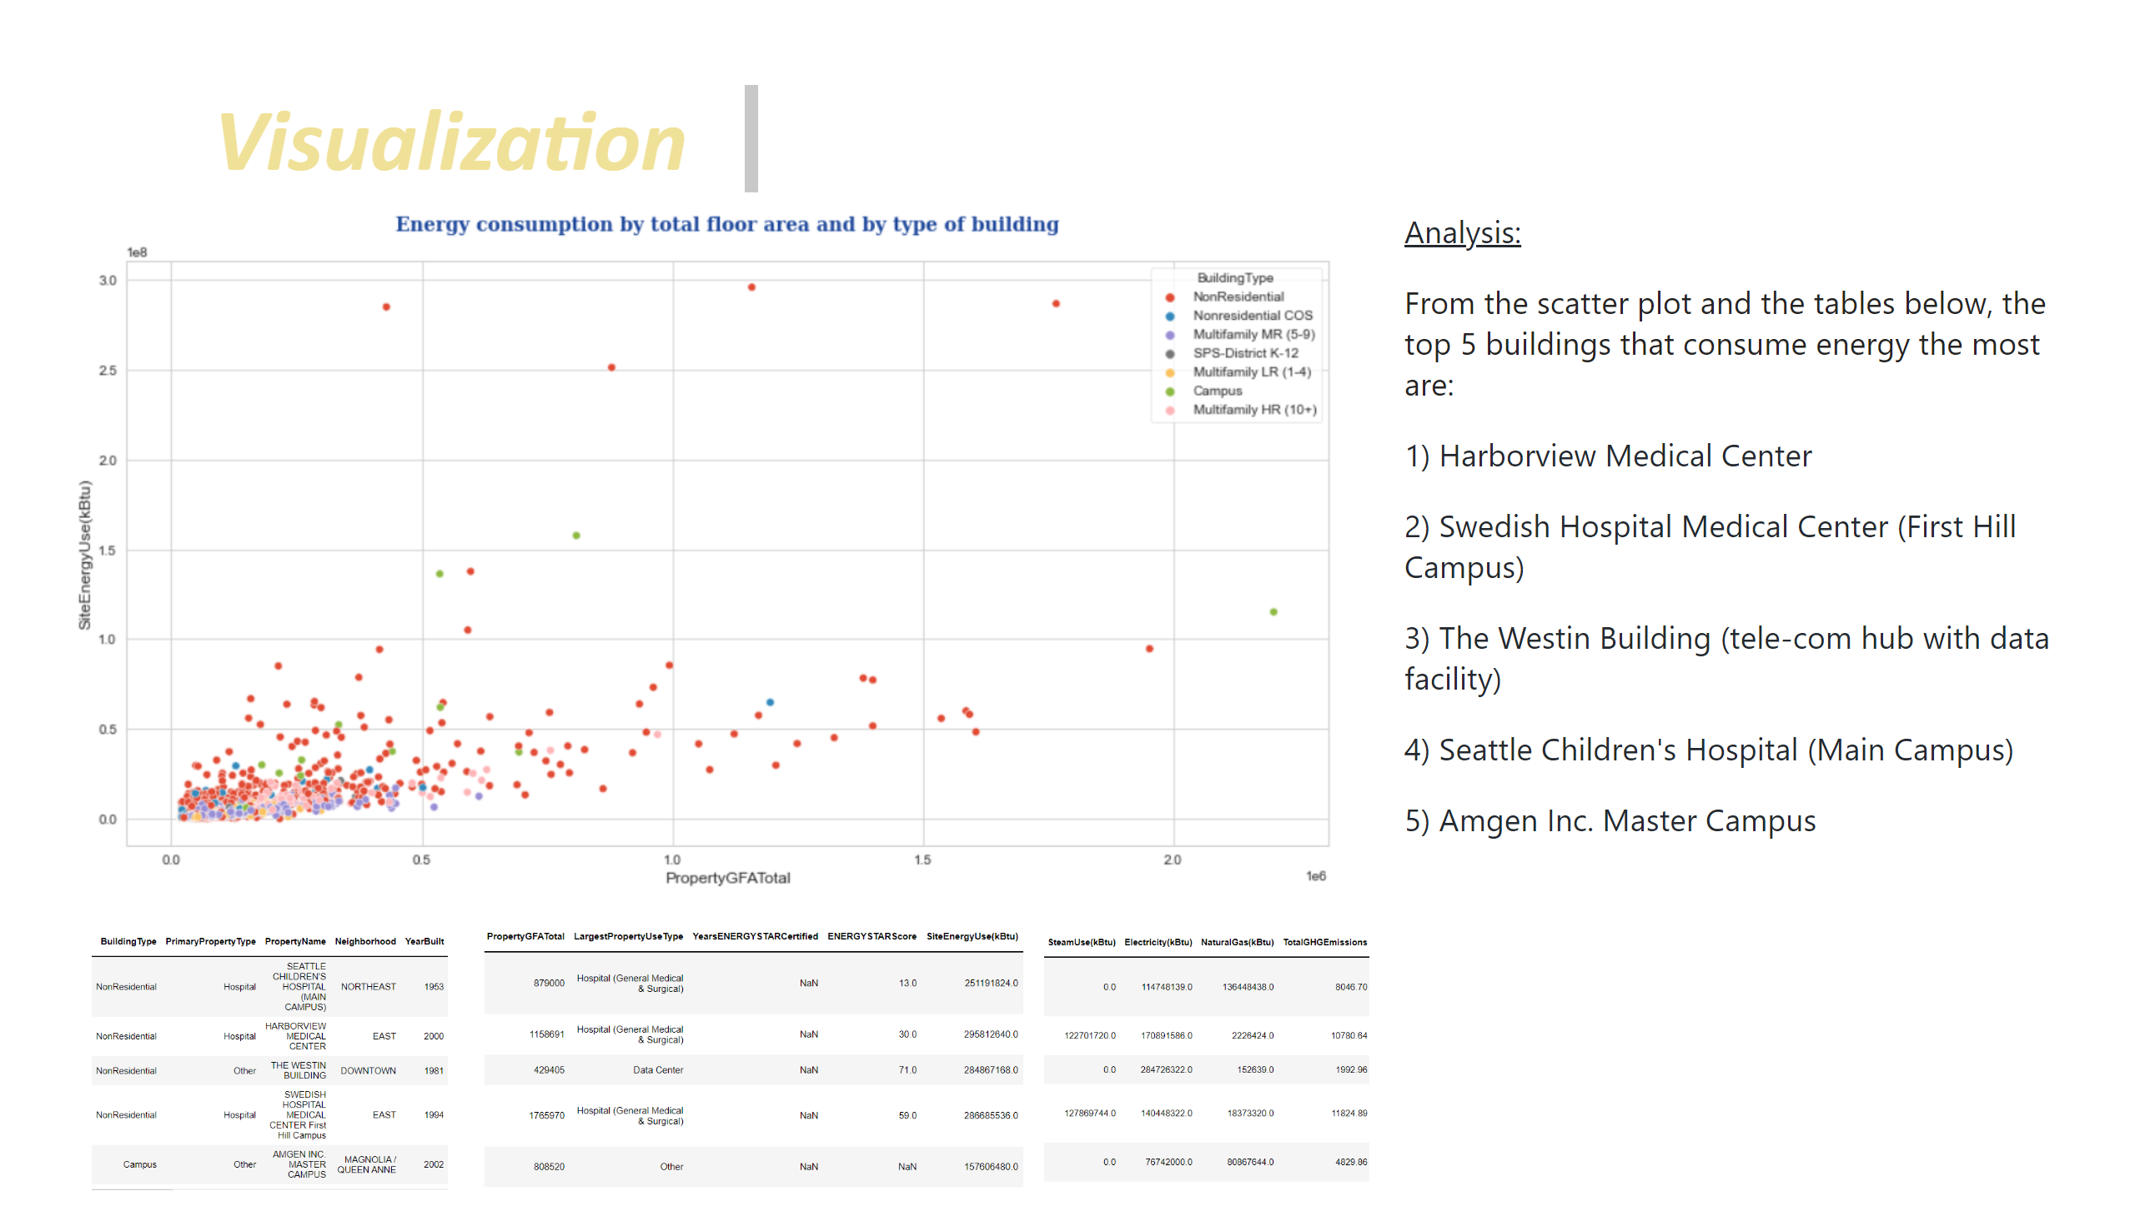
Visualization_5
Notes:
textbox
No alt text provided
image
No alt text provided
image
No alt text provided
image
No alt text provided
image
No alt text provided
textbox
No alt text provided

Slide 14
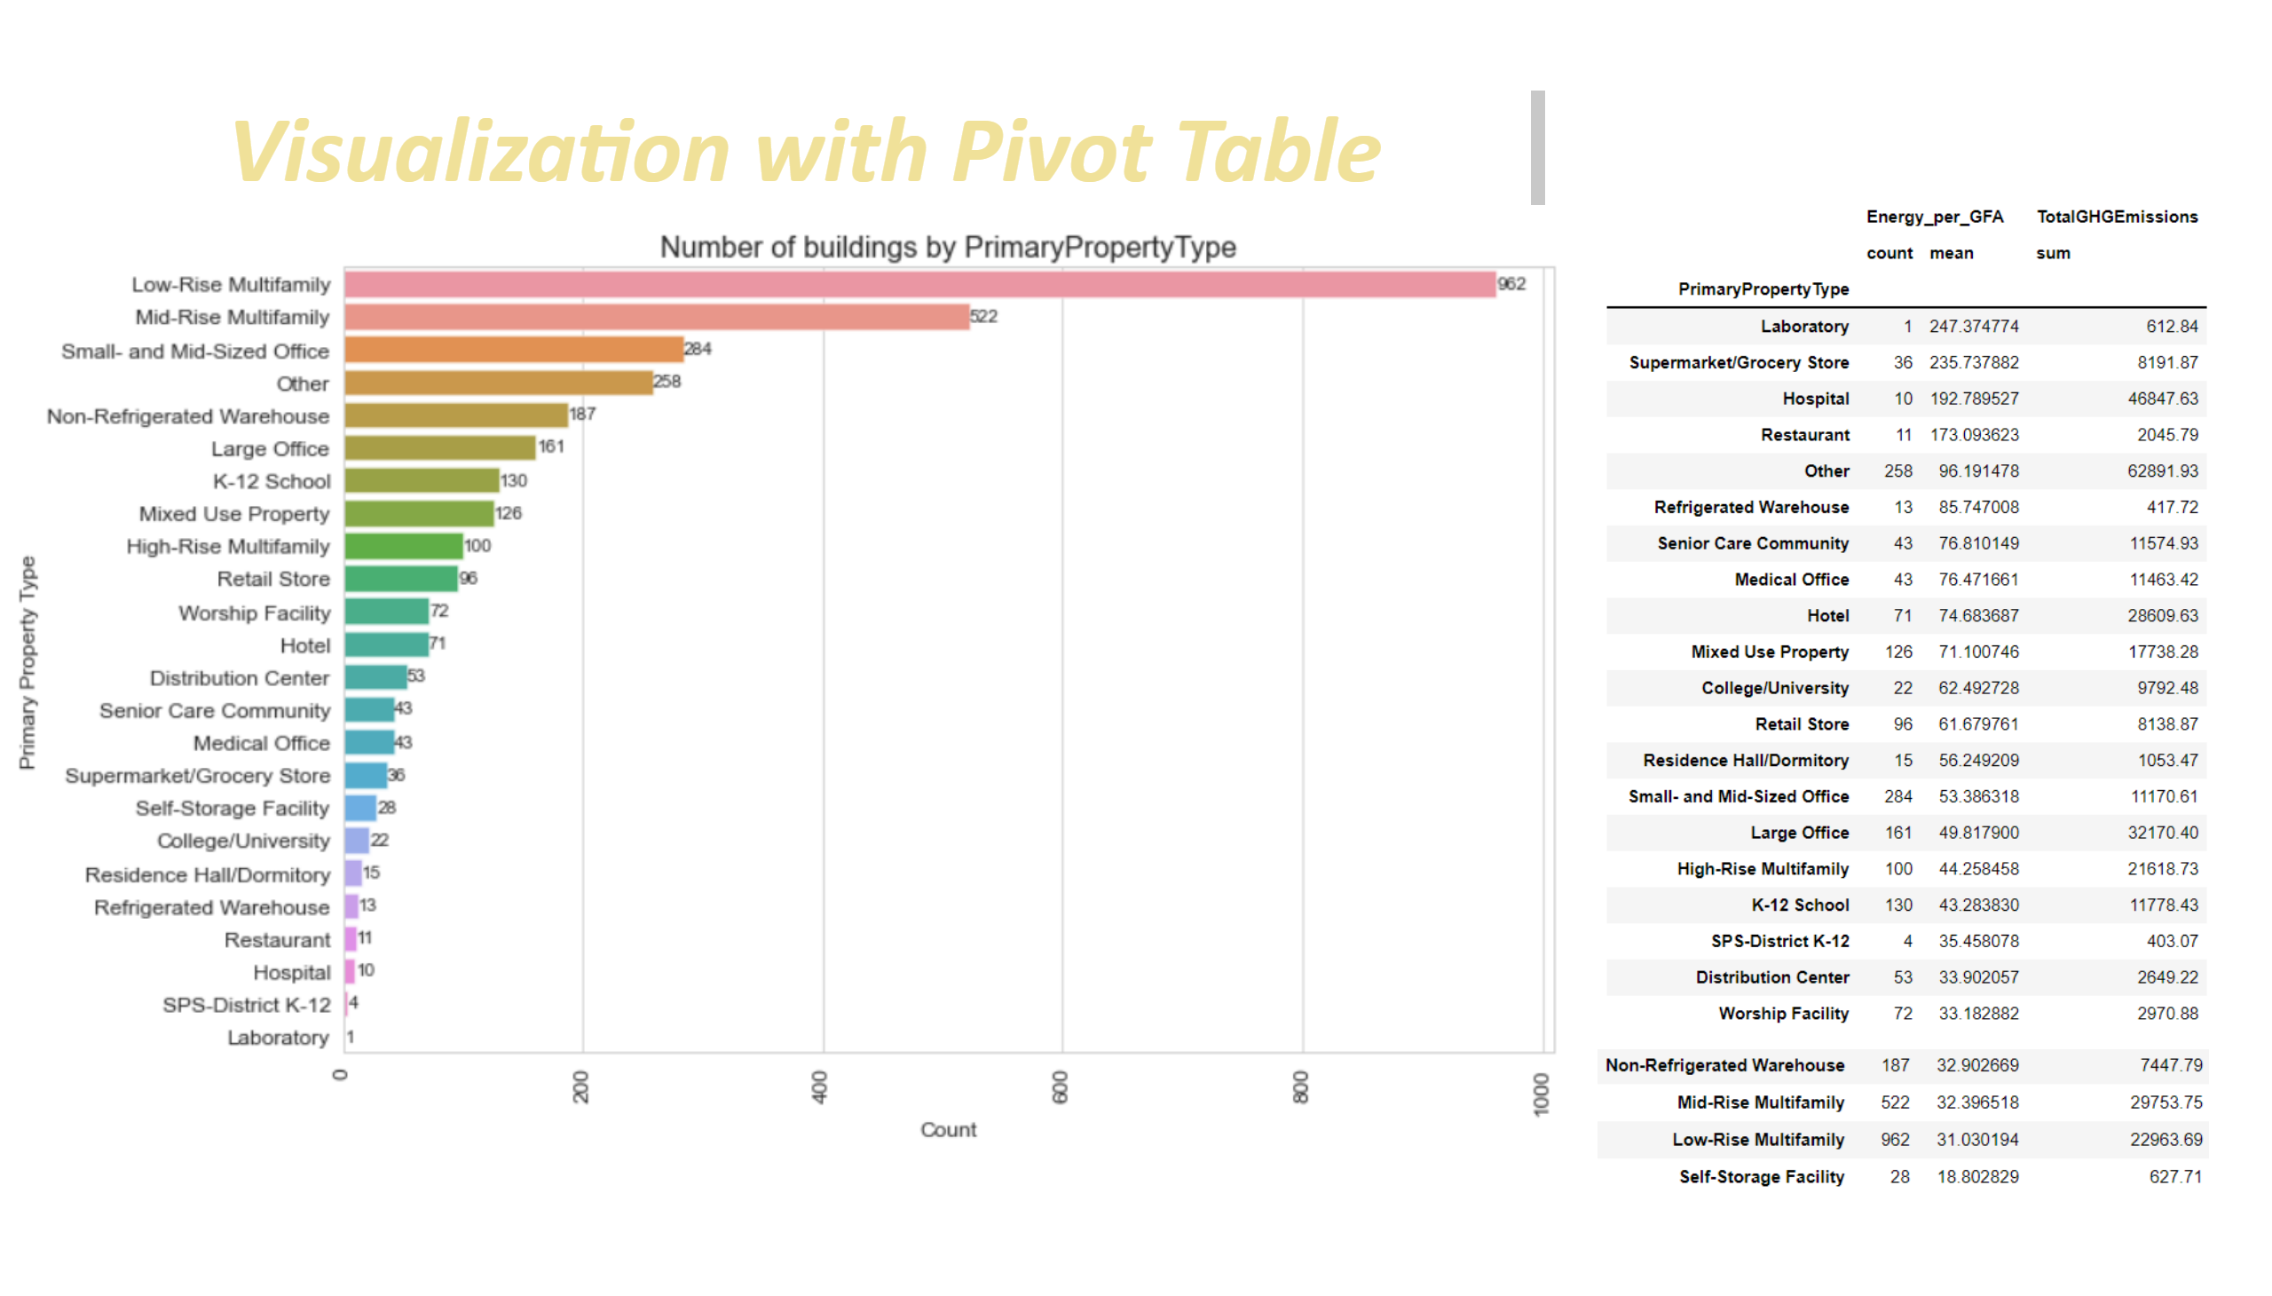
Visualization_6
Notes:
textbox
No alt text provided
image
No alt text provided
image
No alt text provided
image
No alt text provided

Slide 15
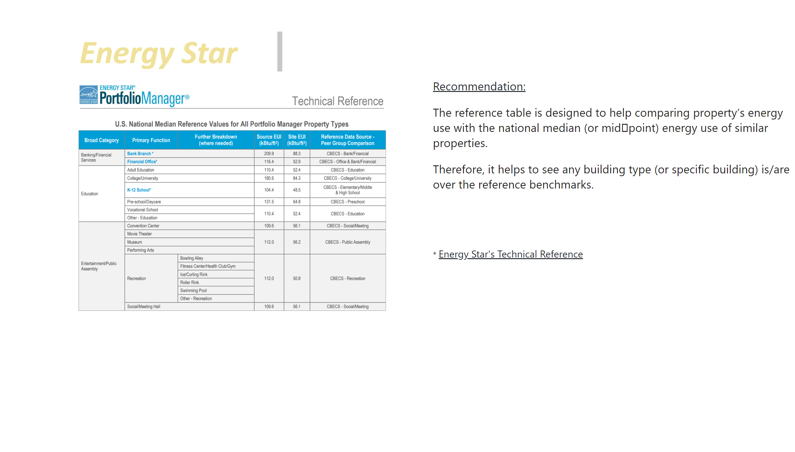
Energy_Star
Notes:
textbox
No alt text provided
image
No alt text provided
textbox
No alt text provided

Slide 16
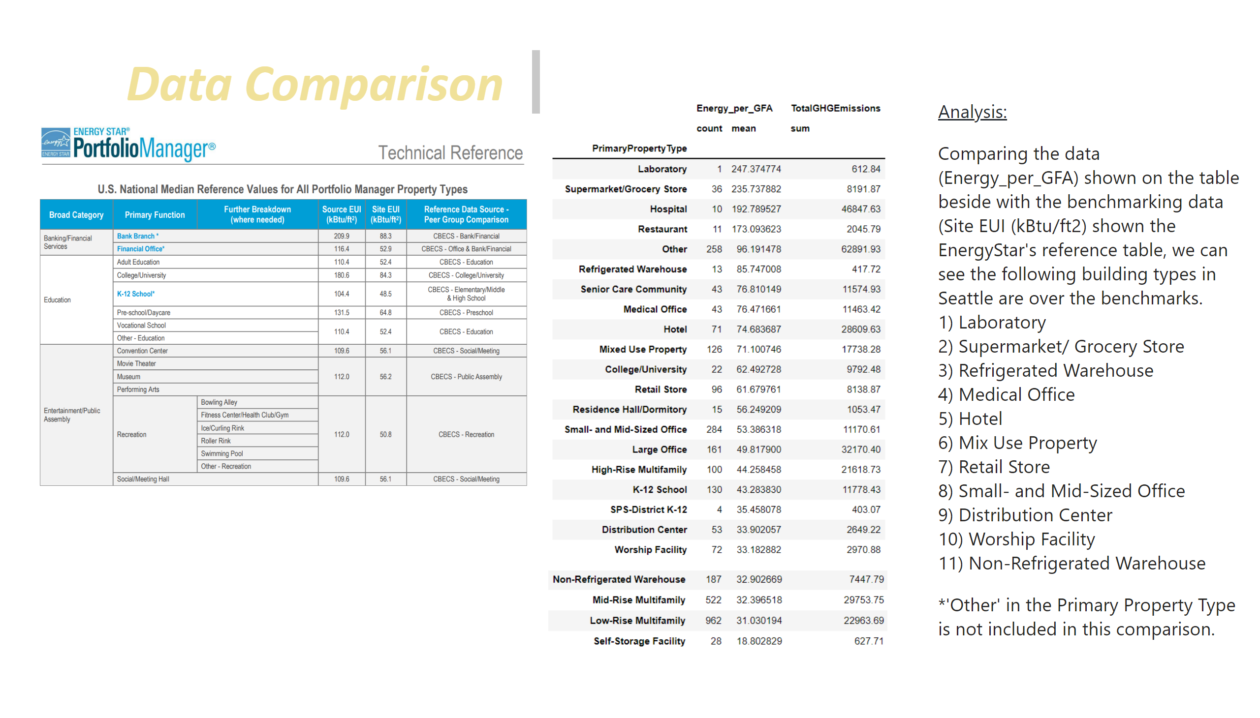
Energy_Star_1
Notes:
textbox
No alt text provided
image
No alt text provided
textbox
No alt text provided
image
No alt text provided
image
No alt text provided

Slide 17
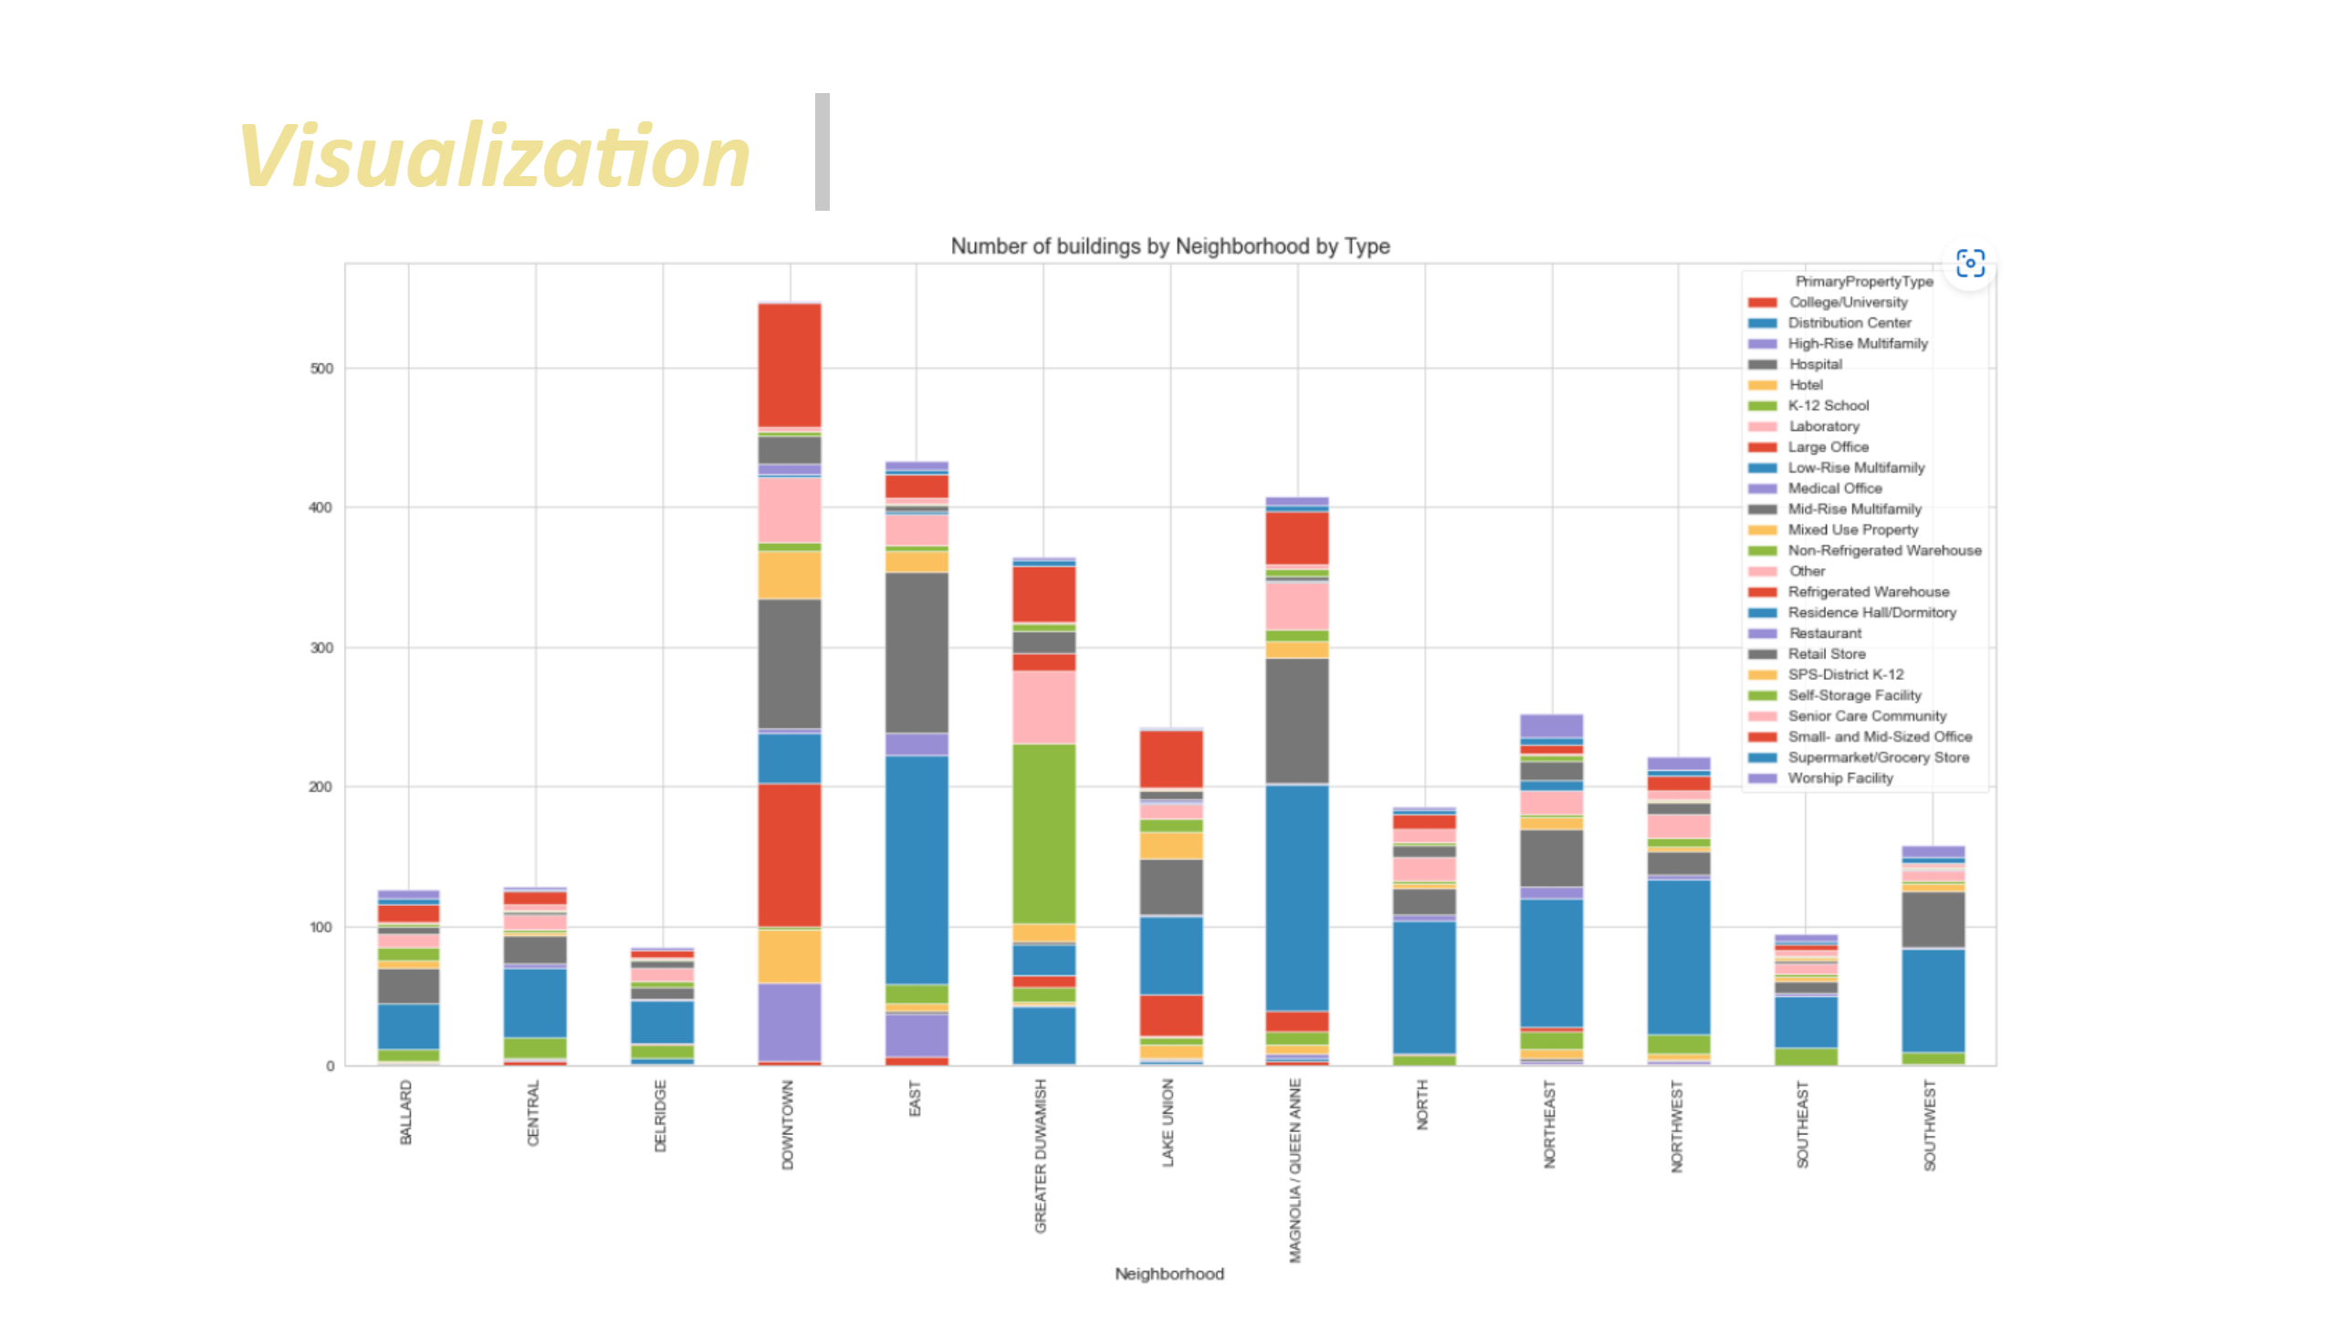
Visualization_7
Notes:
textbox
No alt text provided
image
No alt text provided

Slide 18
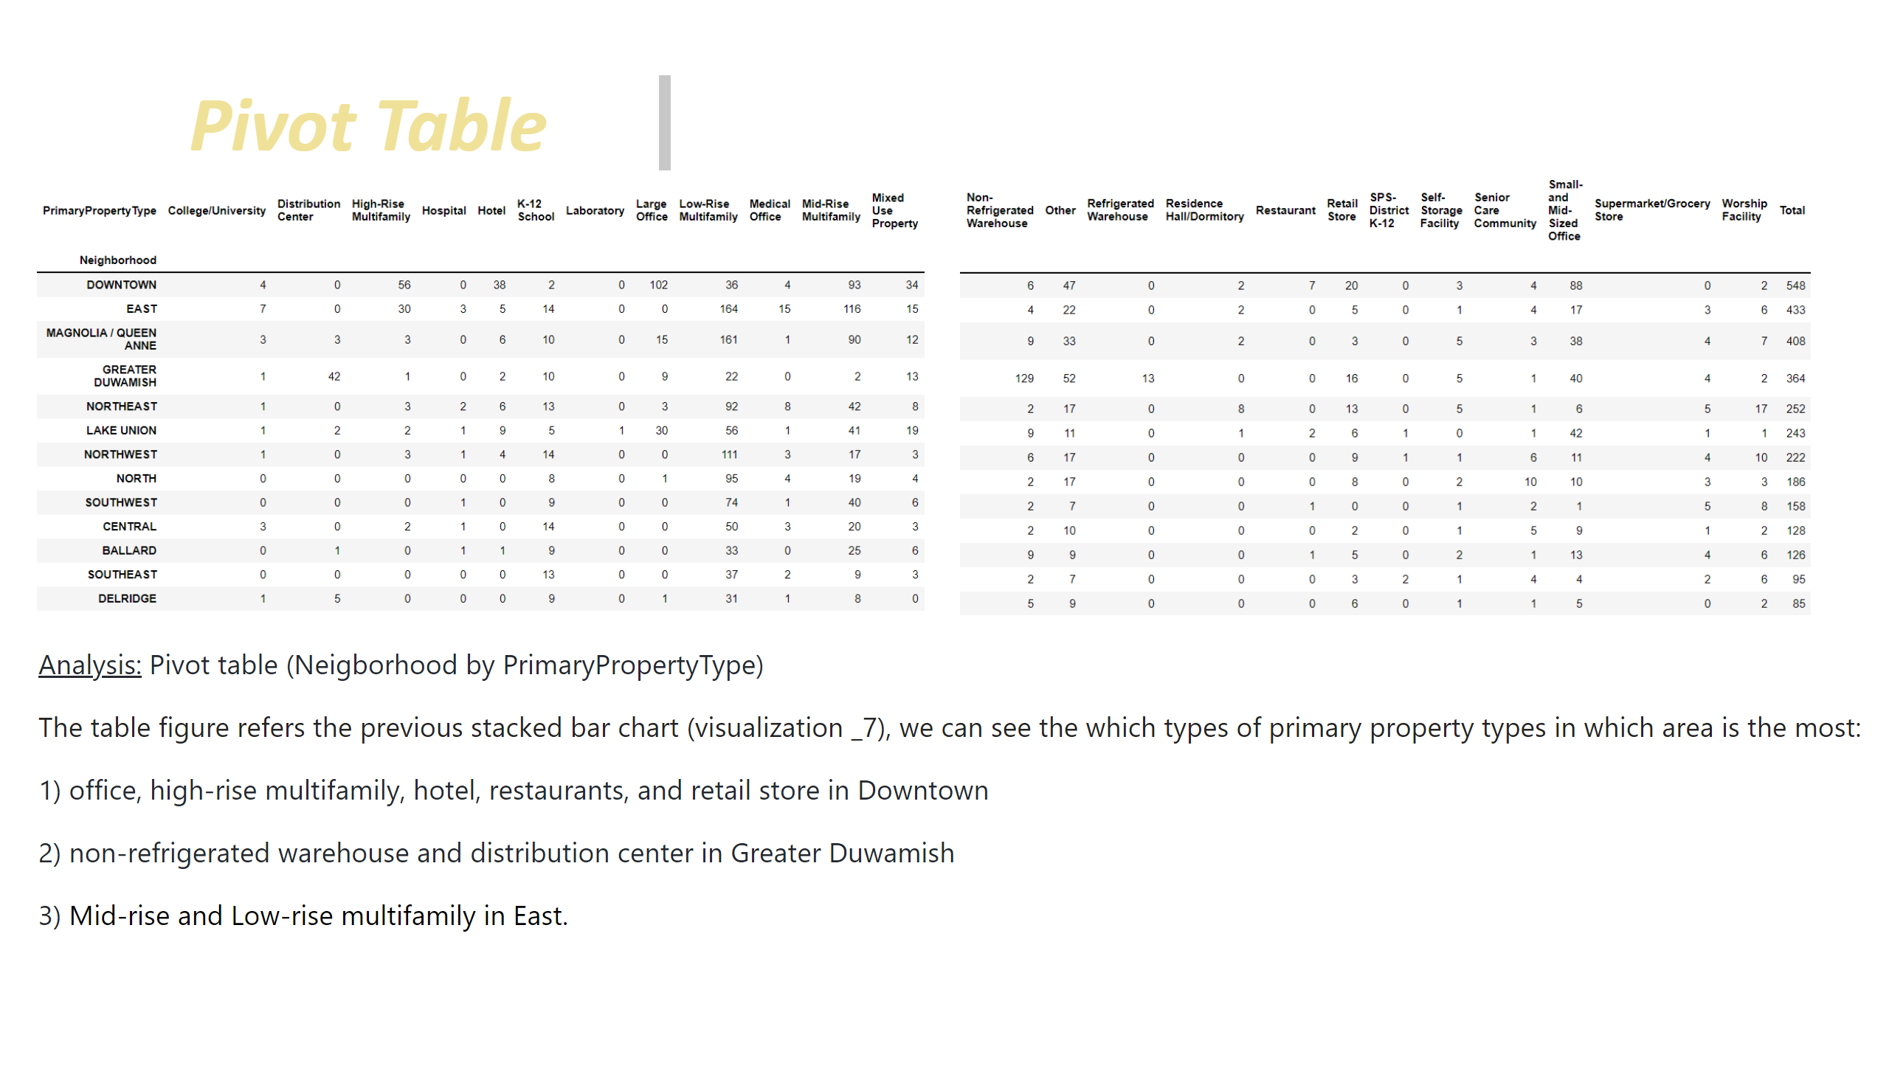
Pivot Table_1
Notes:
textbox
No alt text provided
image
No alt text provided
image
No alt text provided
textbox
No alt text provided

Slide 19
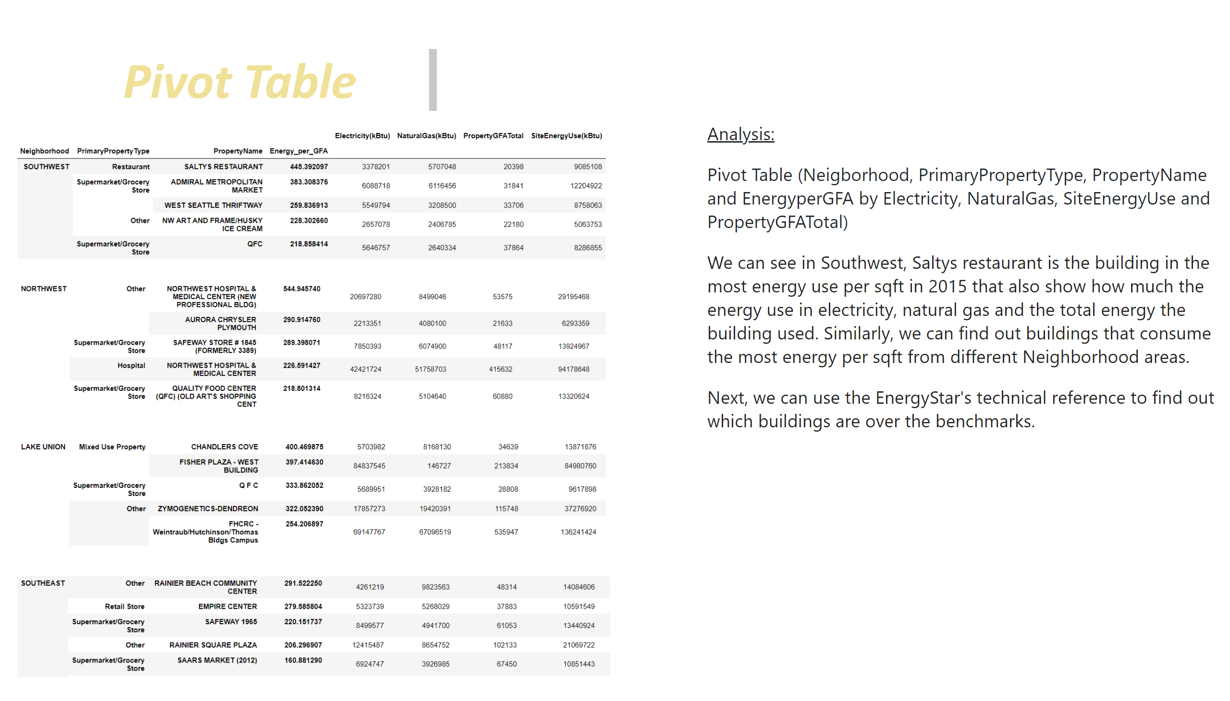
Pivot Table_2
Notes:
textbox
No alt text provided
image
No alt text provided
image
No alt text provided
image
No alt text provided
image
No alt text provided
textbox
No alt text provided

Slide 20
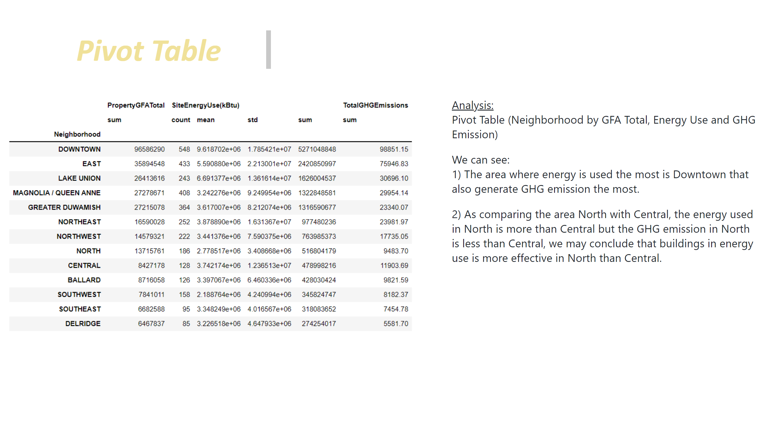
Pivot Table_3
Notes:
textbox
No alt text provided
image
No alt text provided
textbox
No alt text provided

Slide 21
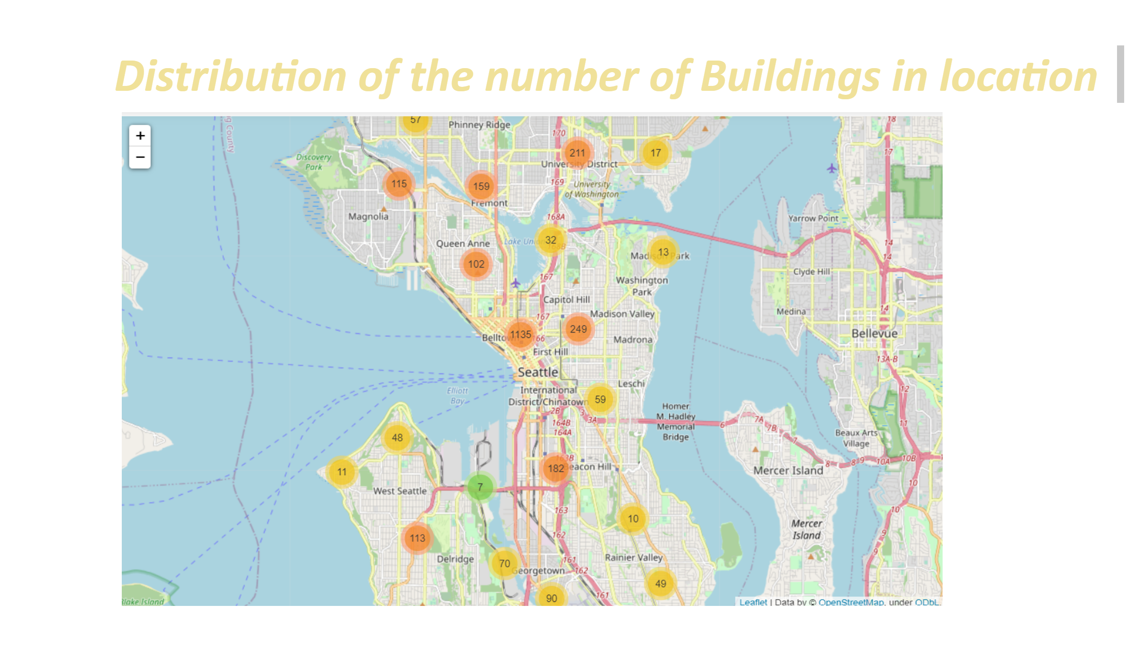
Location Map
Notes:
textbox
No alt text provided
image
No alt text provided

Slide 22
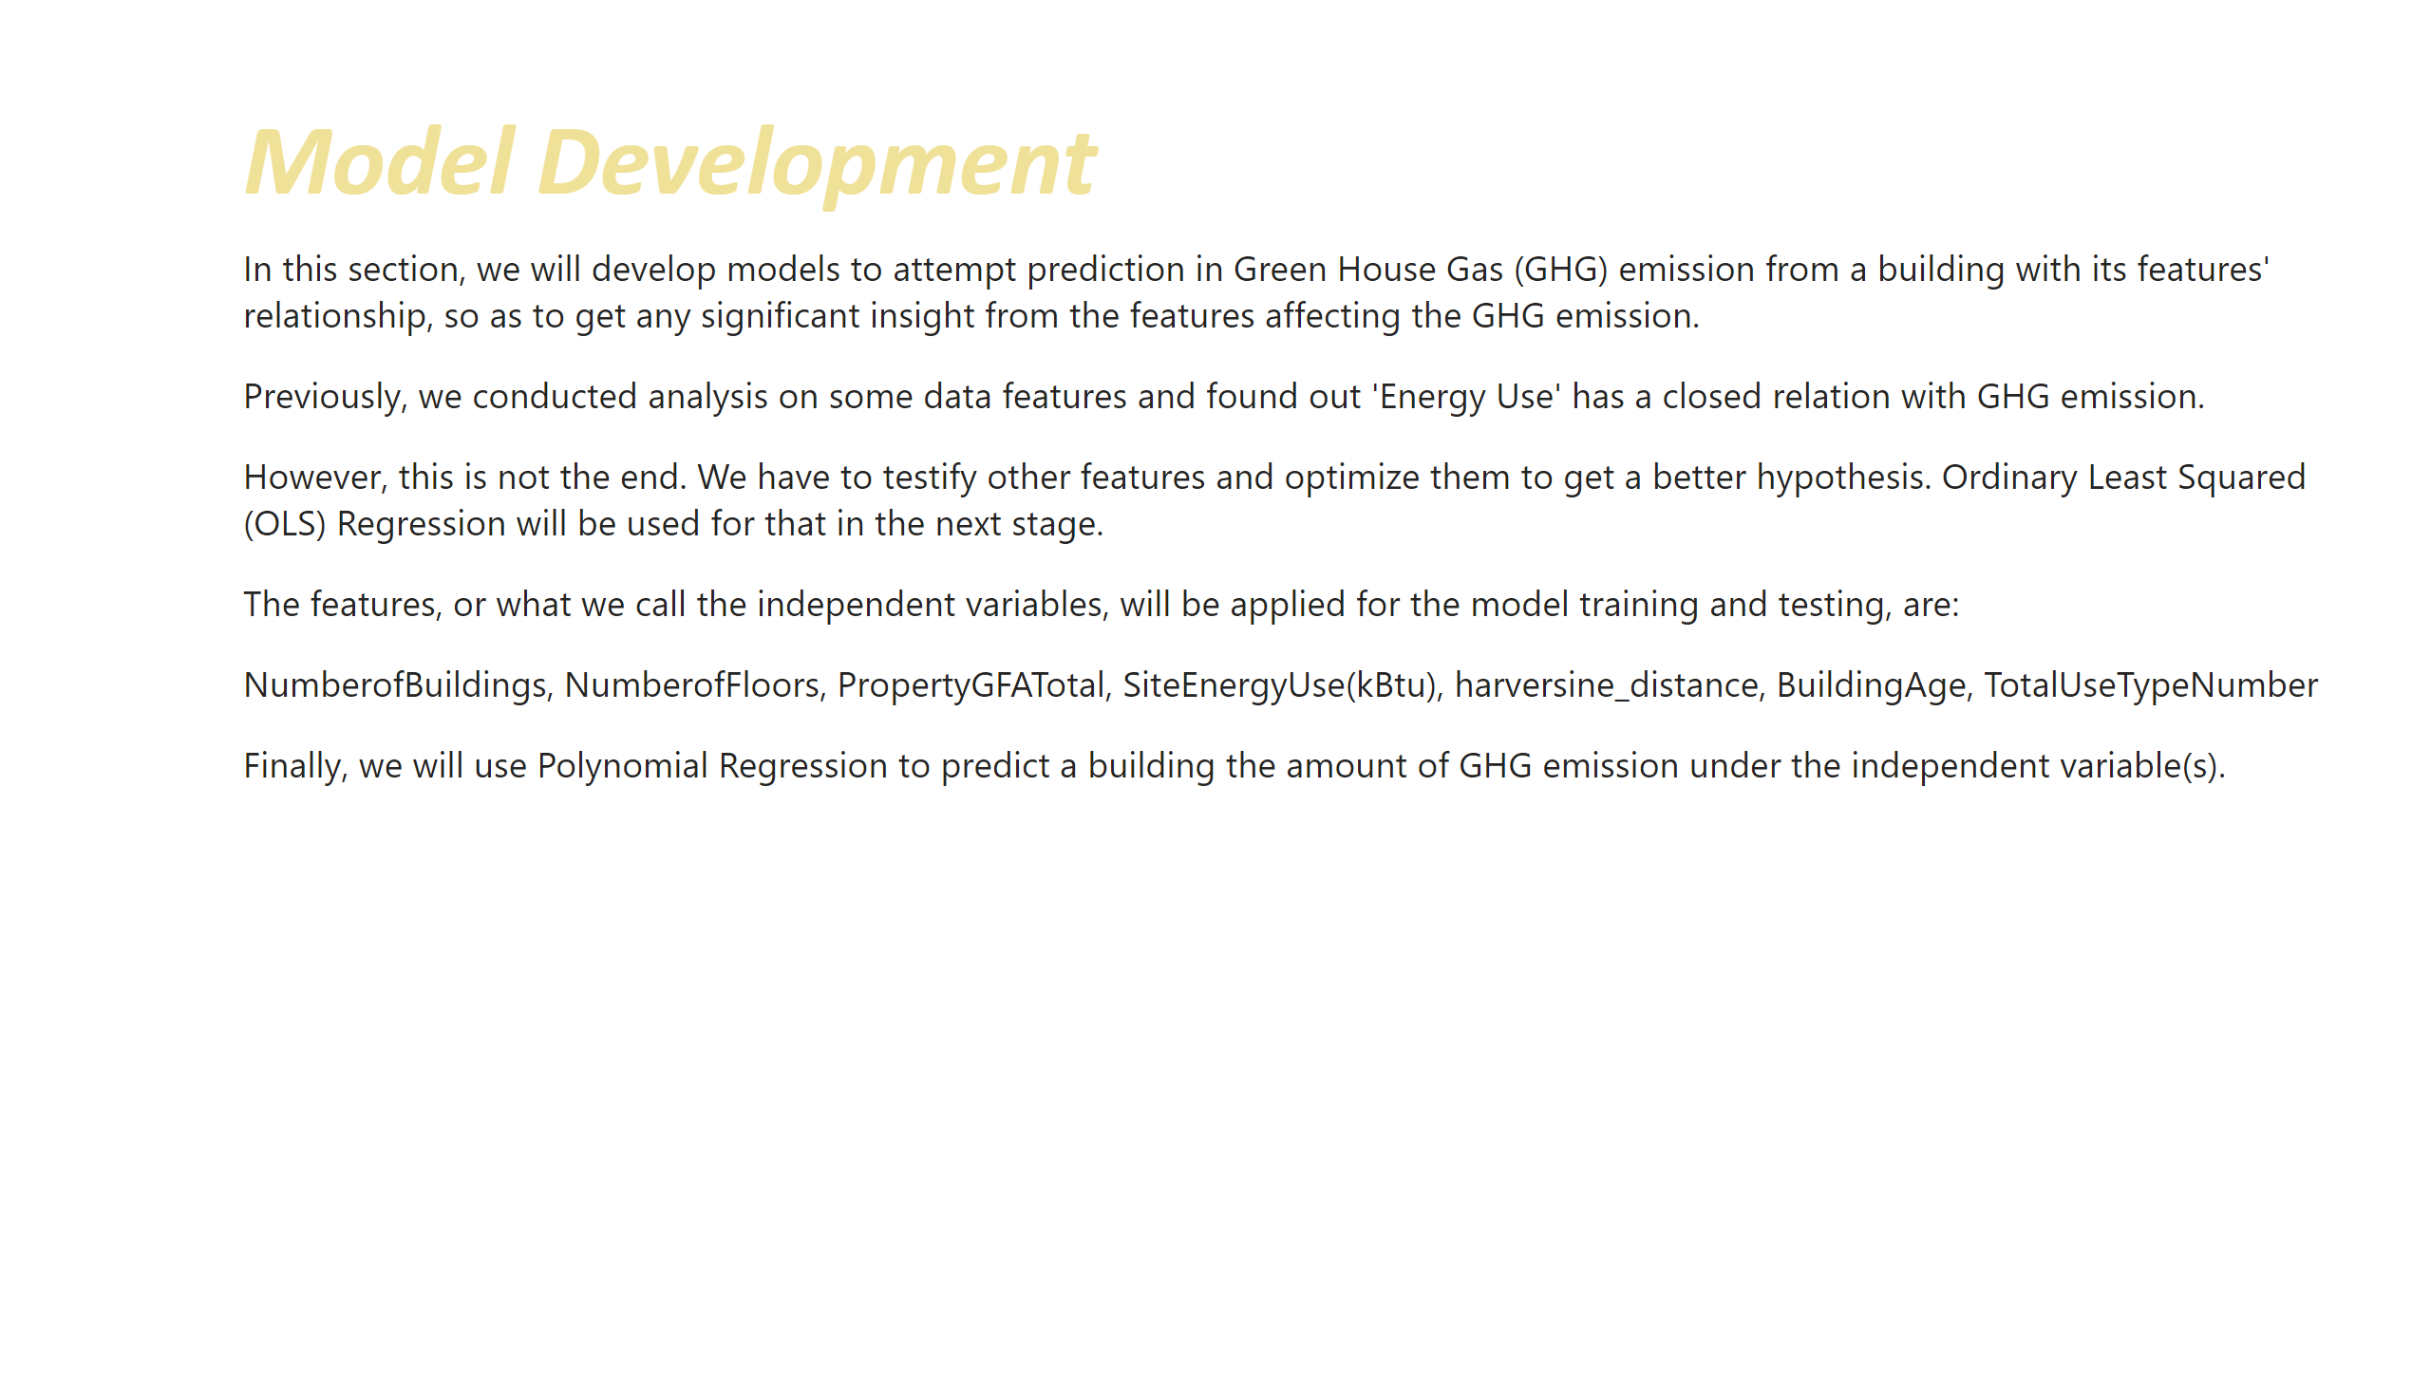
Model
Notes:
textbox
No alt text provided
textbox
No alt text provided

Slide 23
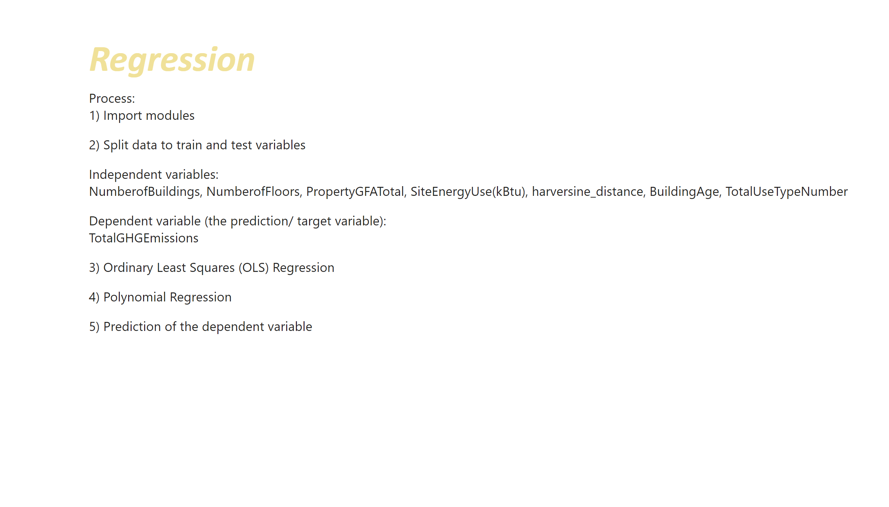
Regression
Notes:
textbox
No alt text provided
textbox
No alt text provided

Slide 24
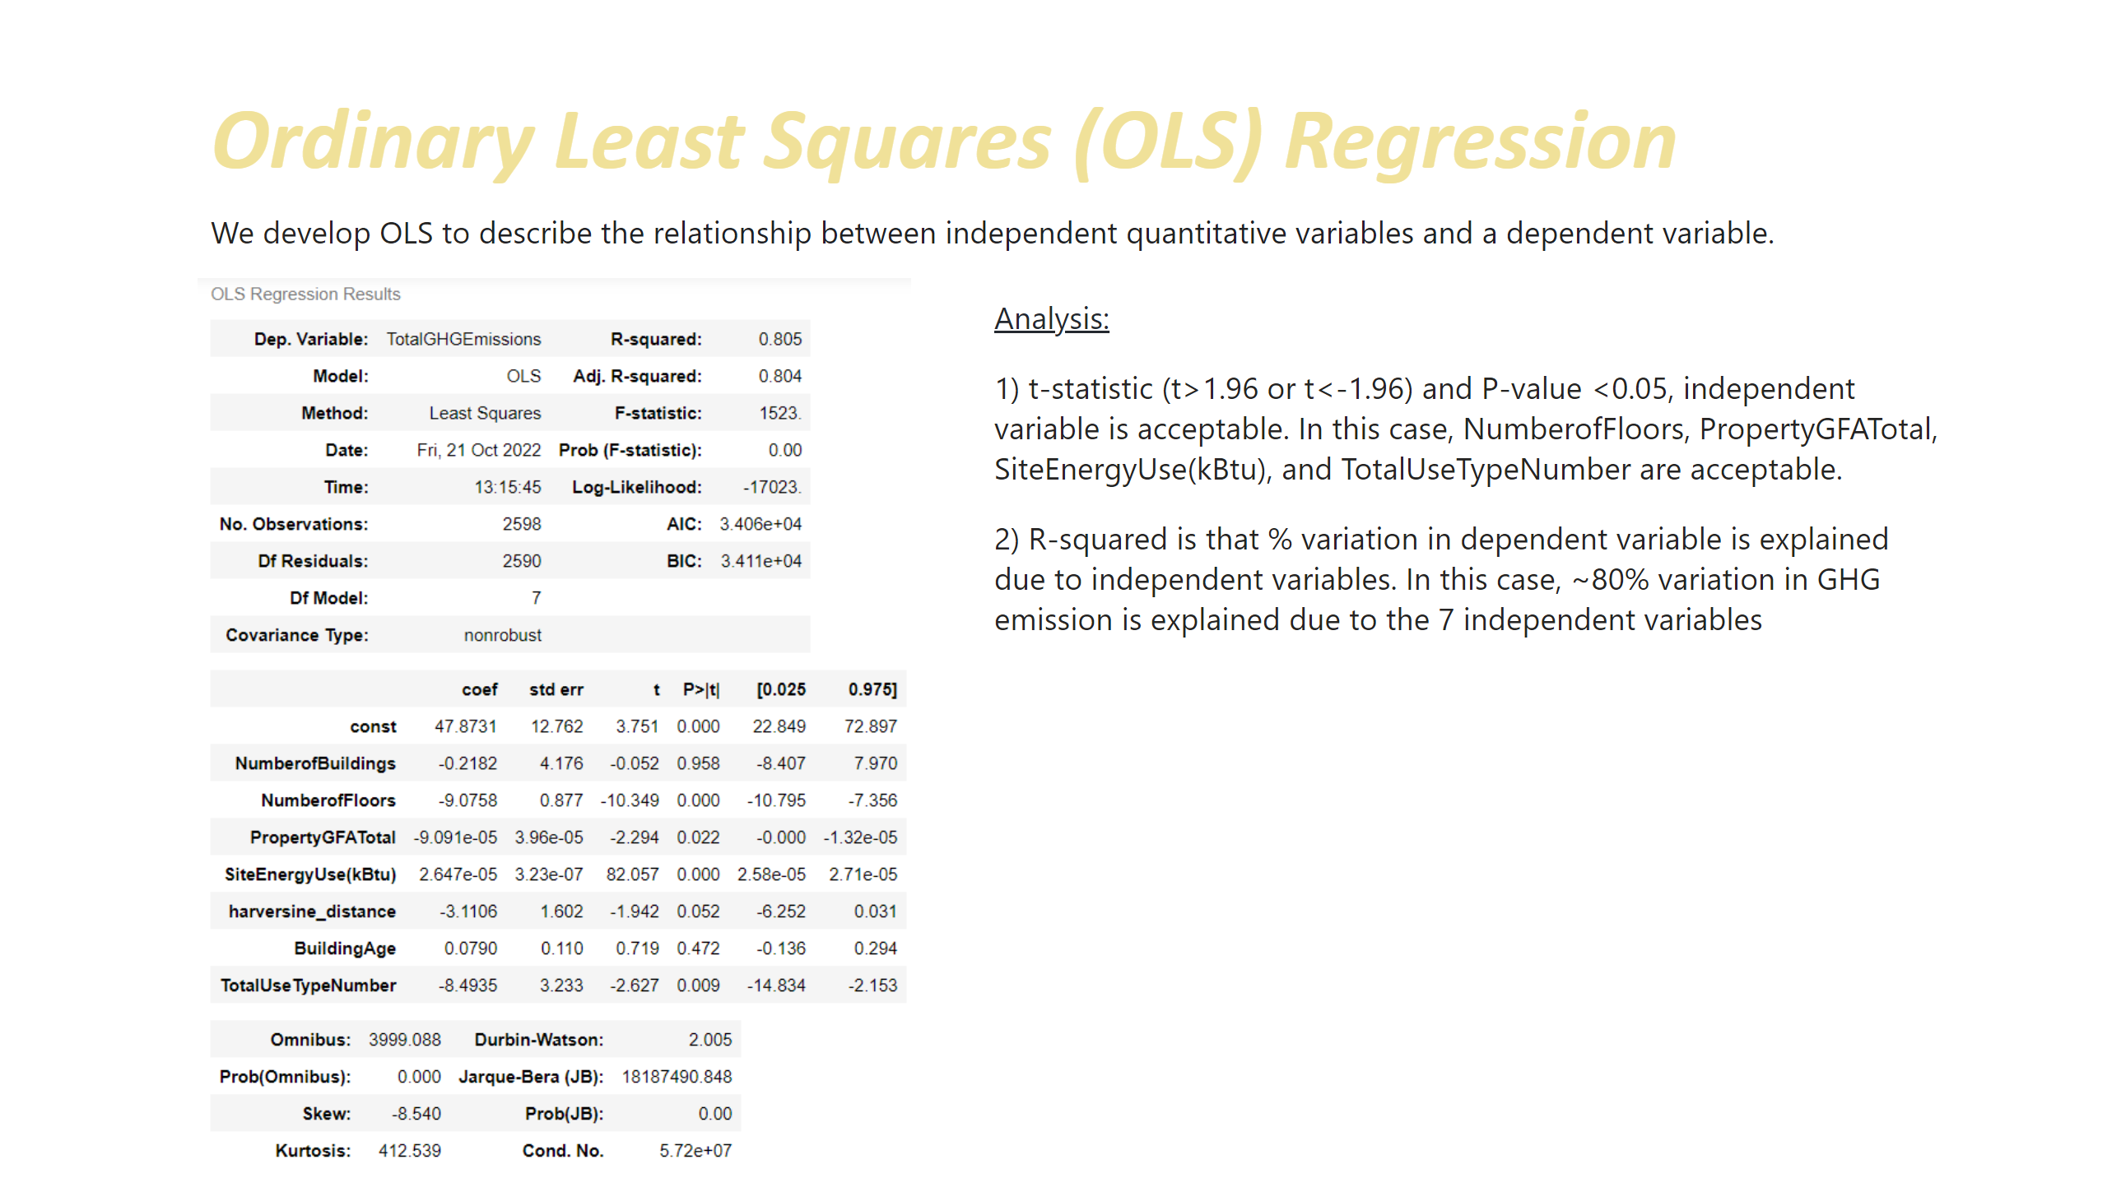
OLS Regression
Notes:
textbox
No alt text provided
textbox
No alt text provided
textbox
No alt text provided
image
No alt text provided

Slide 25
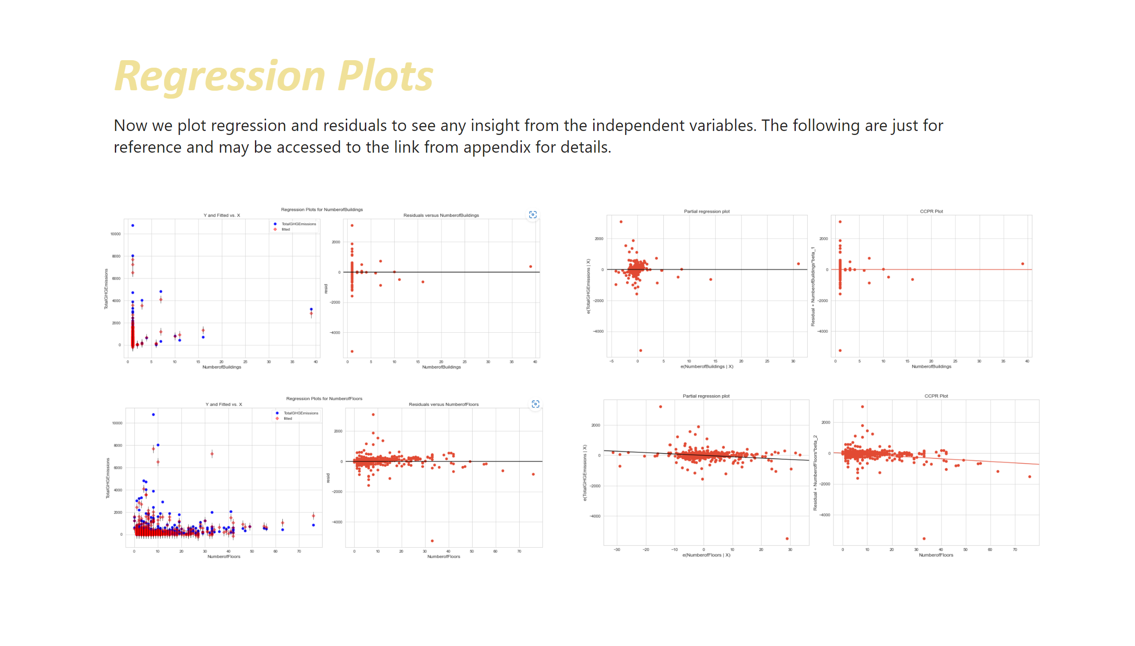
Regression Plots
Notes:
textbox
No alt text provided
textbox
No alt text provided
image
No alt text provided
image
No alt text provided
image
No alt text provided
image
No alt text provided

Slide 26
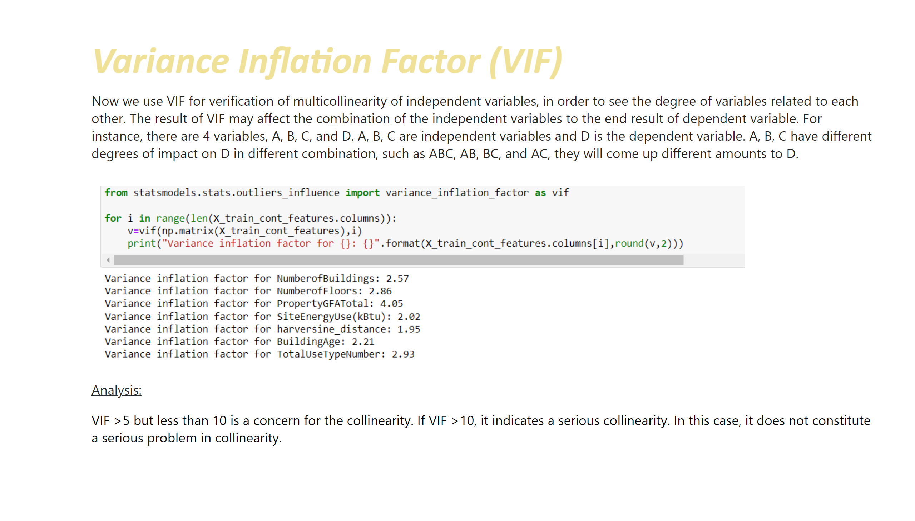
VIF
Notes:
textbox
No alt text provided
textbox
No alt text provided
image
No alt text provided
textbox
No alt text provided

Slide 27
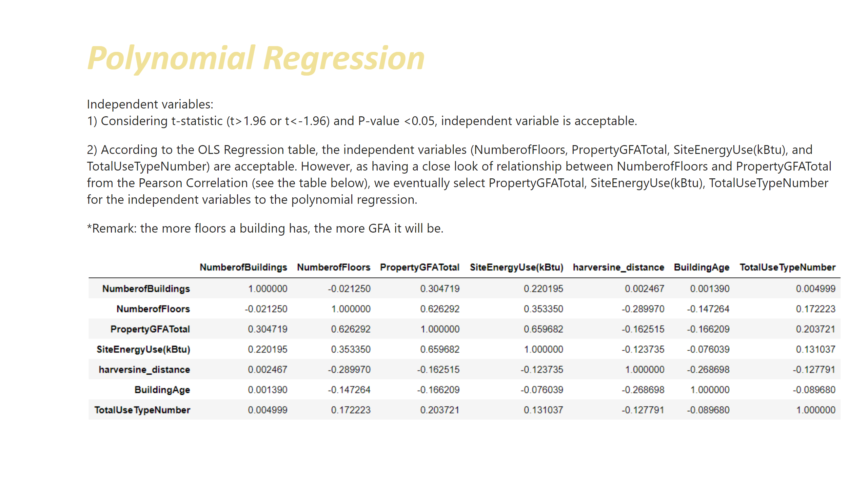
Polynomial Regression_1
Notes:
textbox
No alt text provided
textbox
No alt text provided
image
No alt text provided

Slide 28
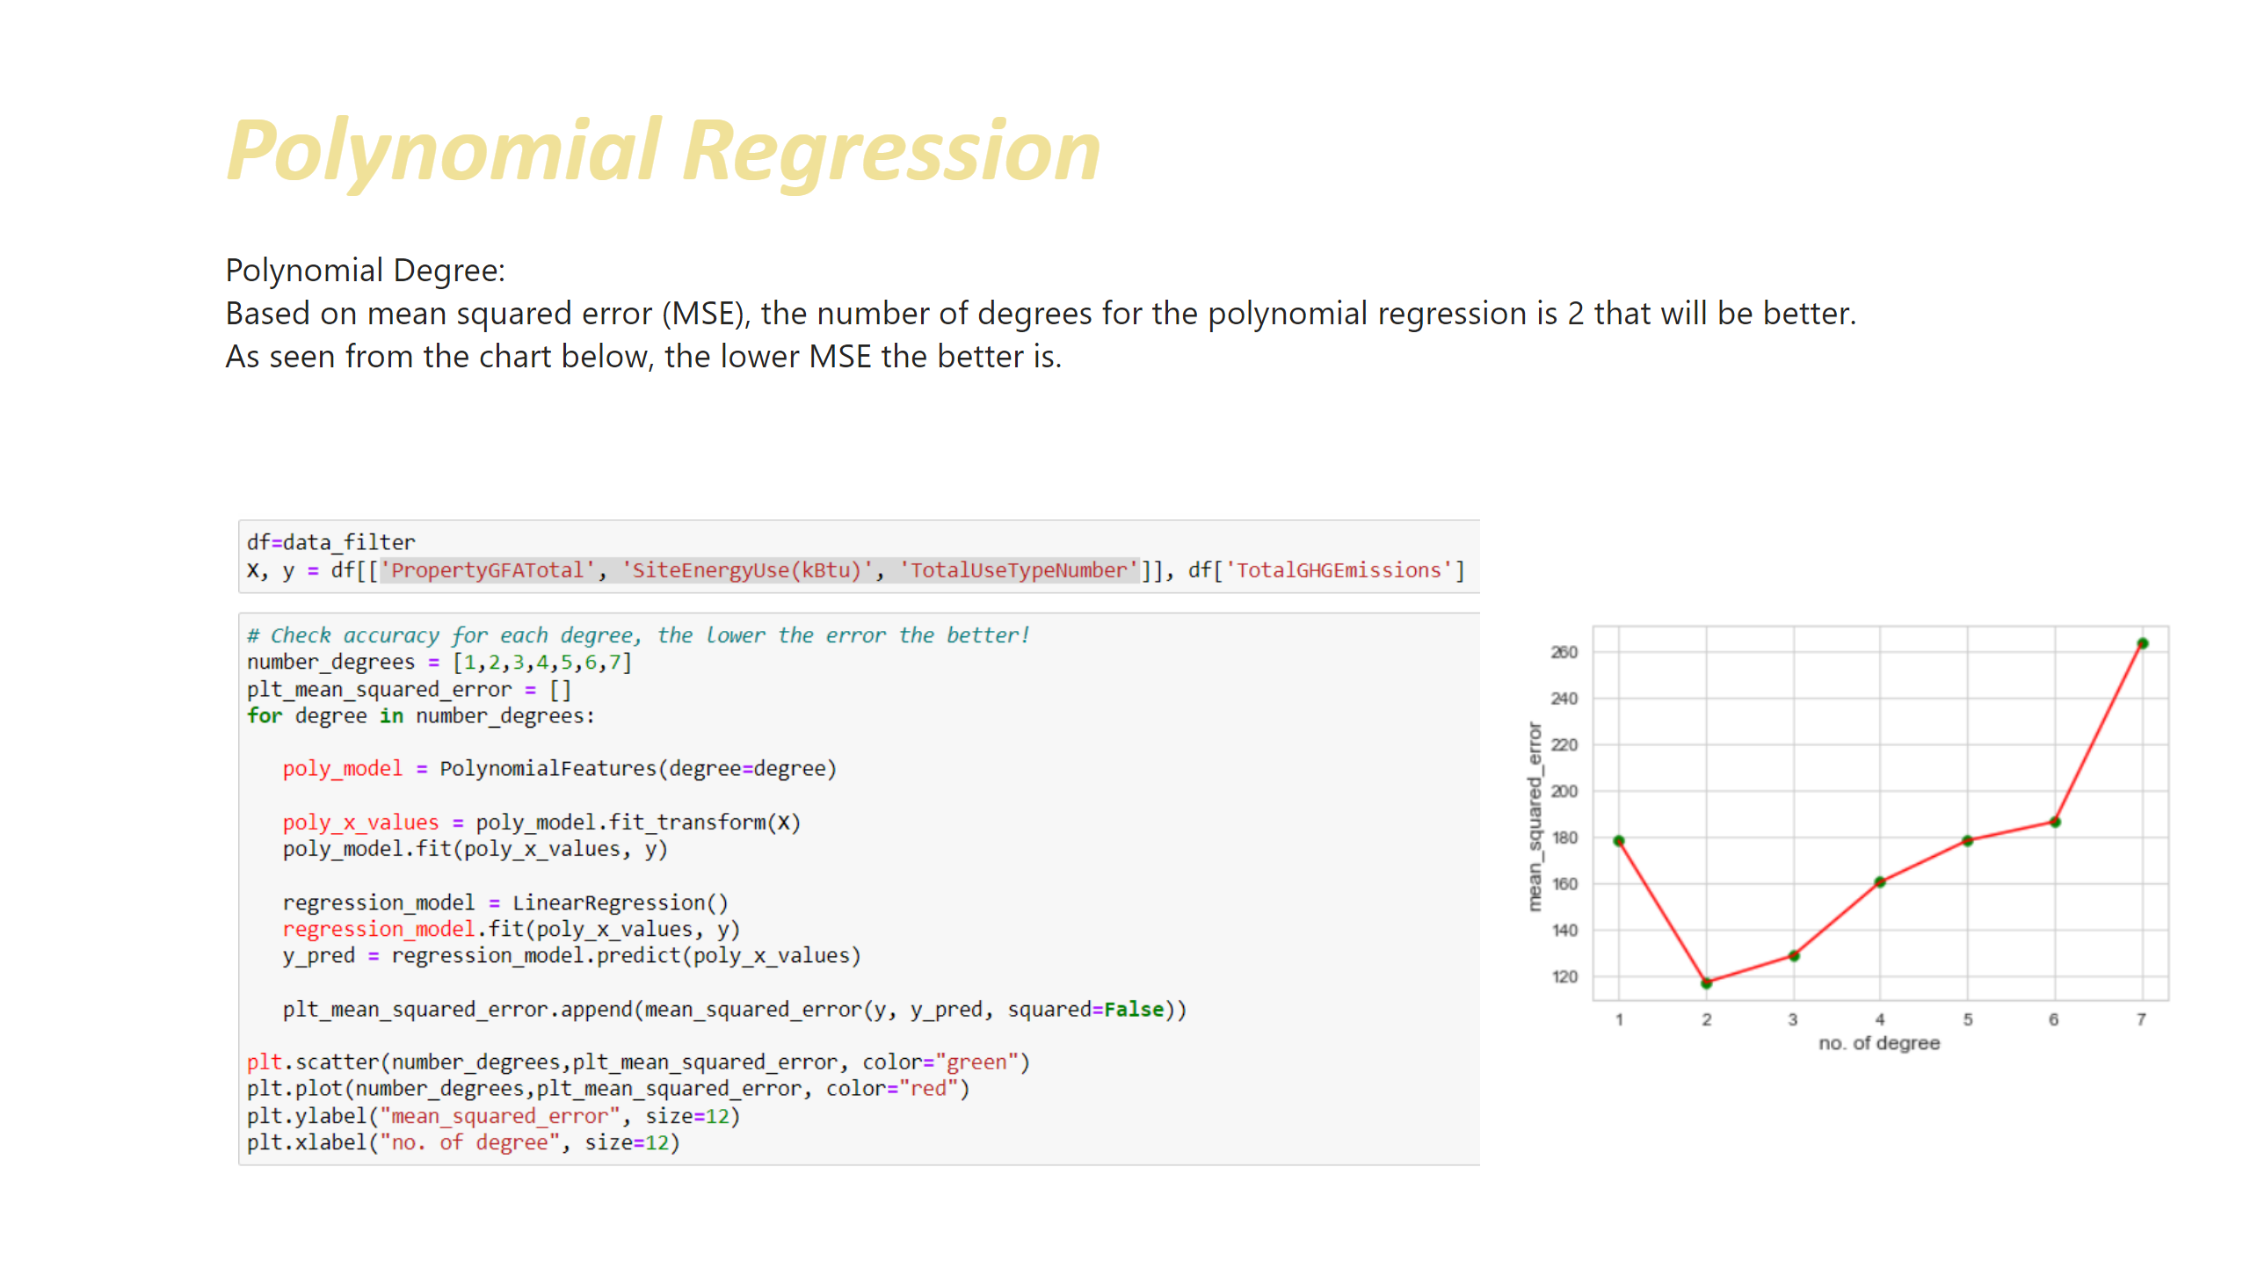
Polynomial Regression_2
Notes:
textbox
No alt text provided
textbox
No alt text provided
image
No alt text provided
image
No alt text provided

Slide 29
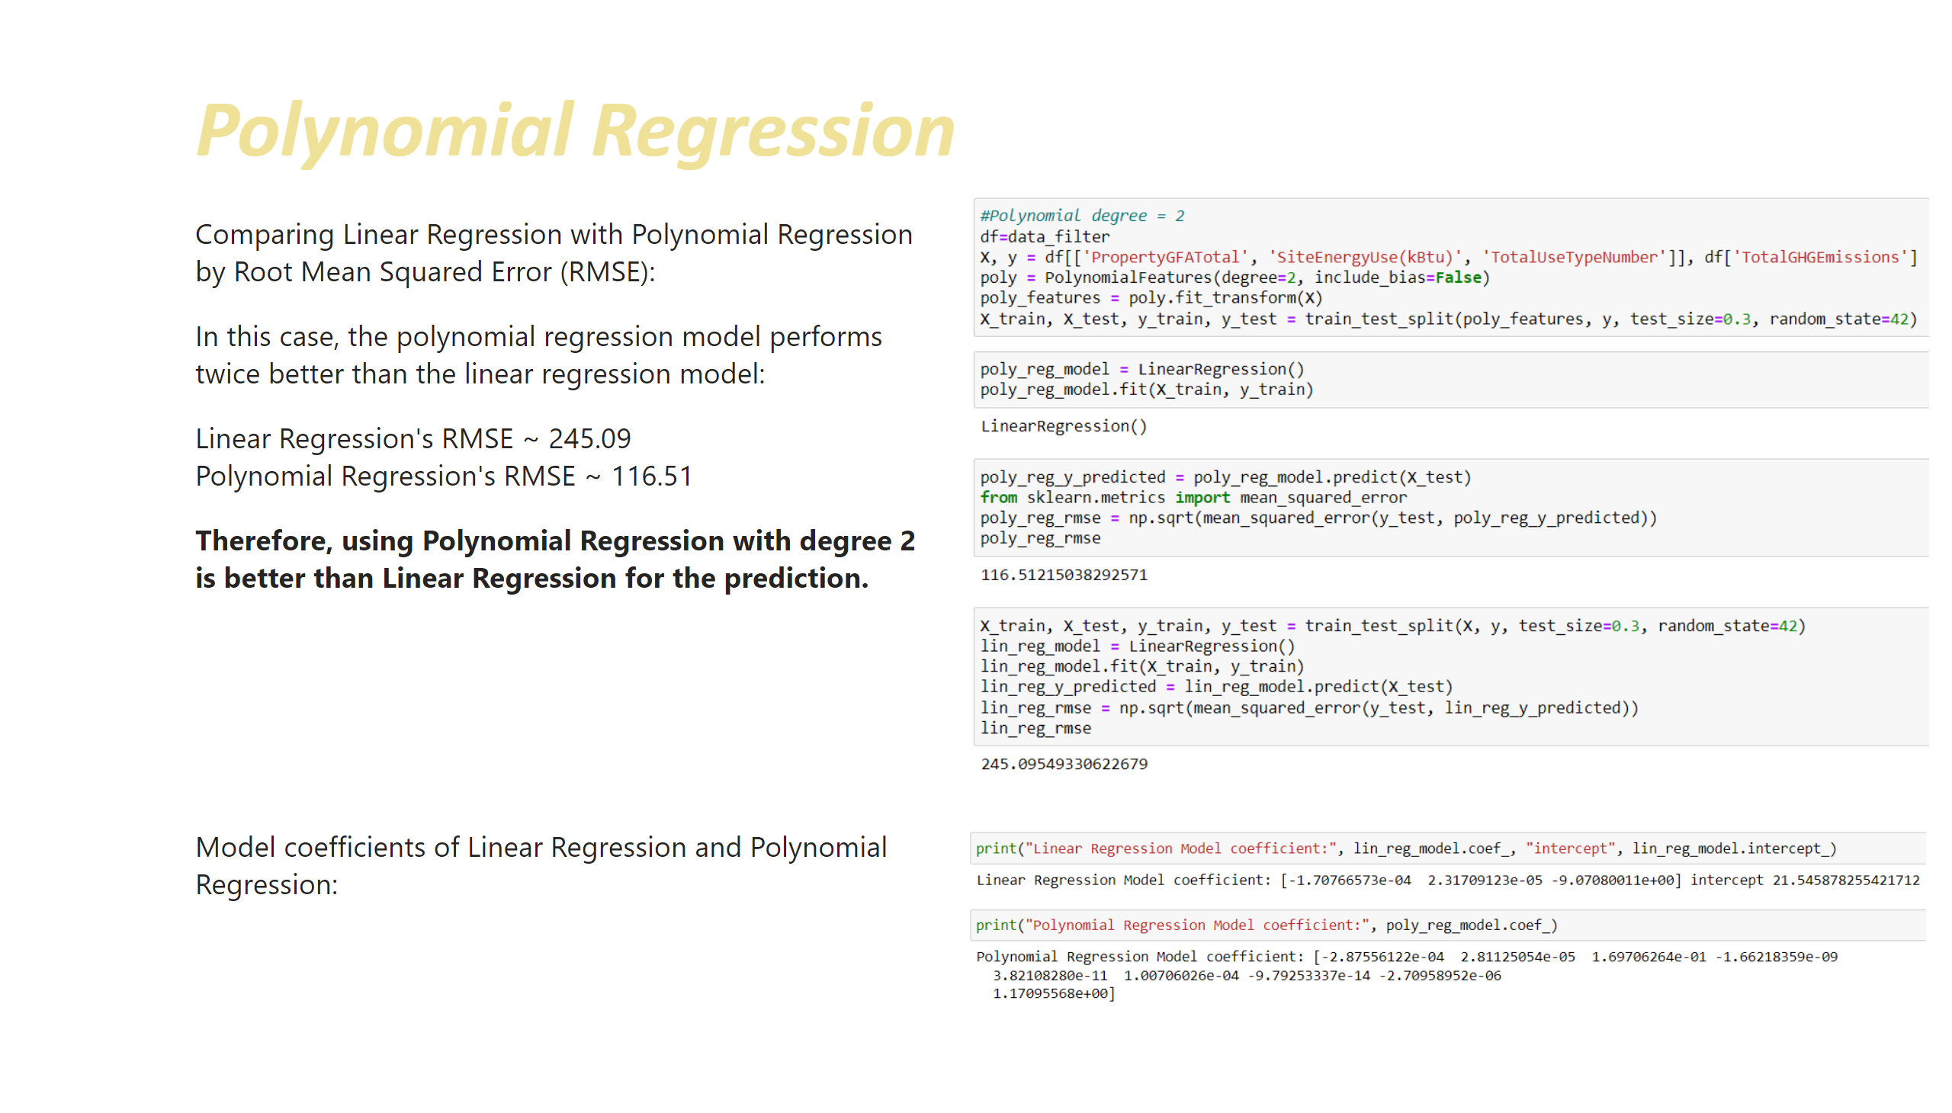
Polynomial Regression_3
Notes:
textbox
No alt text provided
textbox
No alt text provided
image
No alt text provided
image
No alt text provided
textbox
No alt text provided

Slide 30
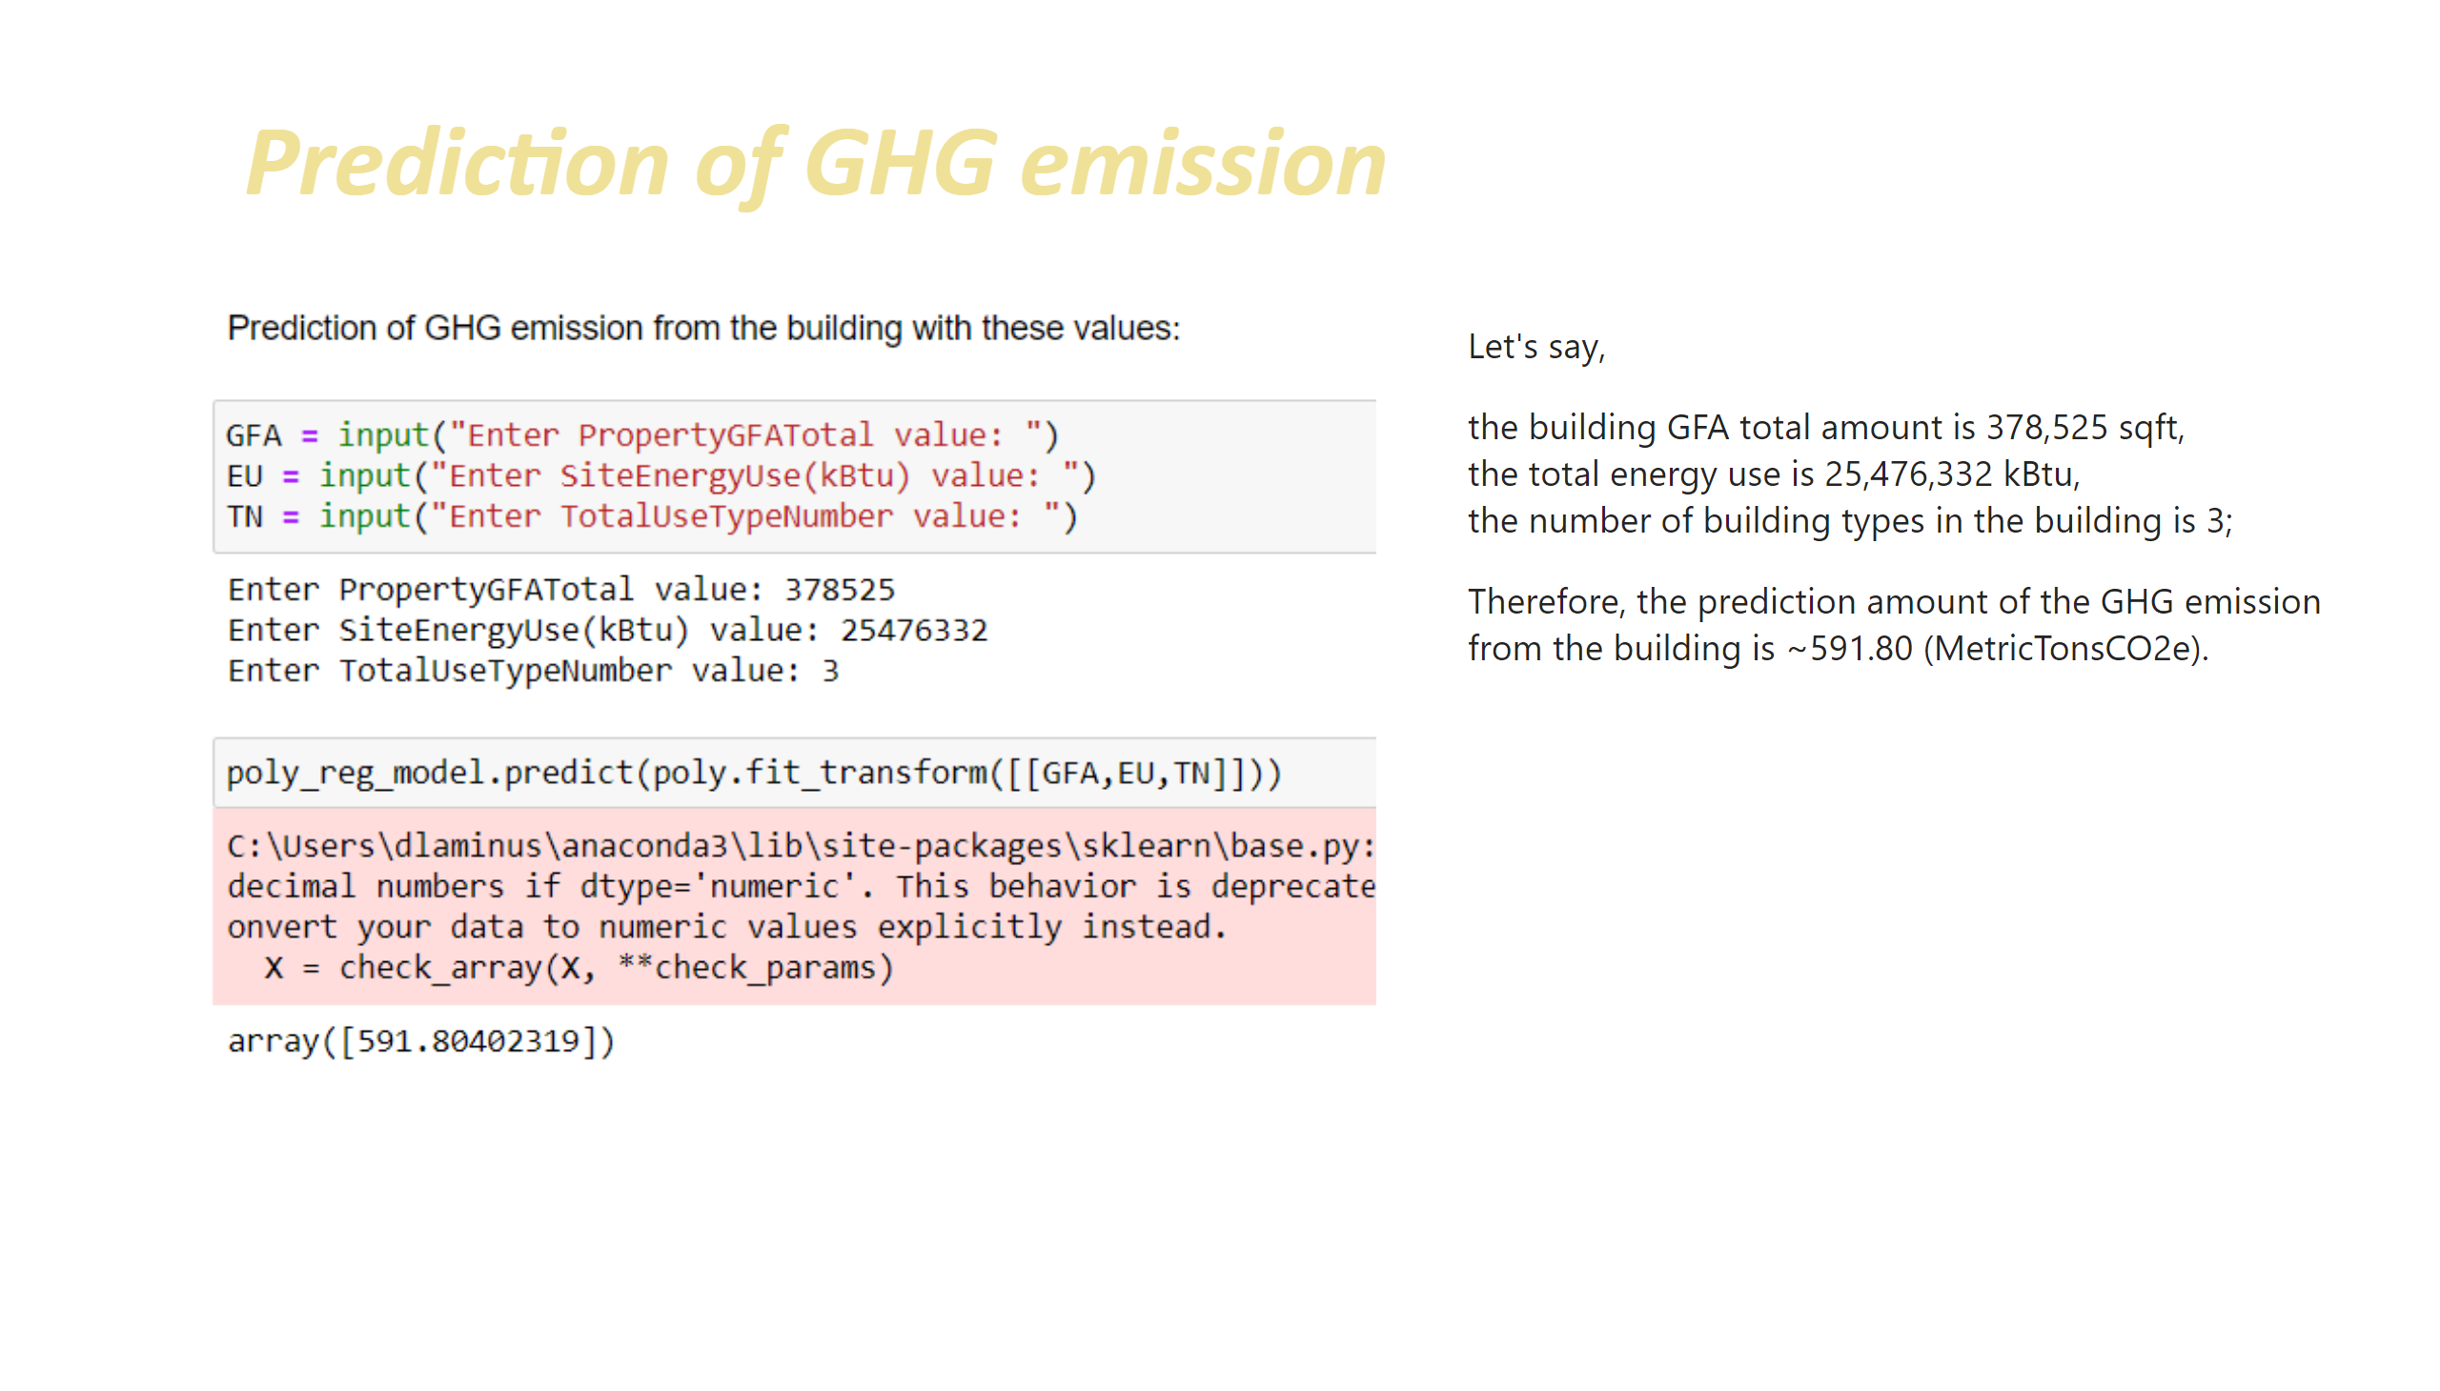
Prediction
Notes:
textbox
No alt text provided
image
No alt text provided
textbox
No alt text provided

Slide 31
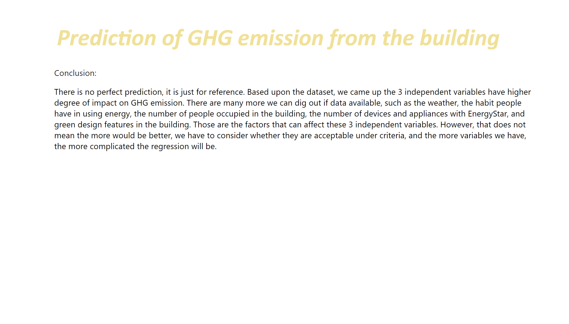
Conclusion
Notes:
textbox
No alt text provided
textbox
No alt text provided

Slide 32
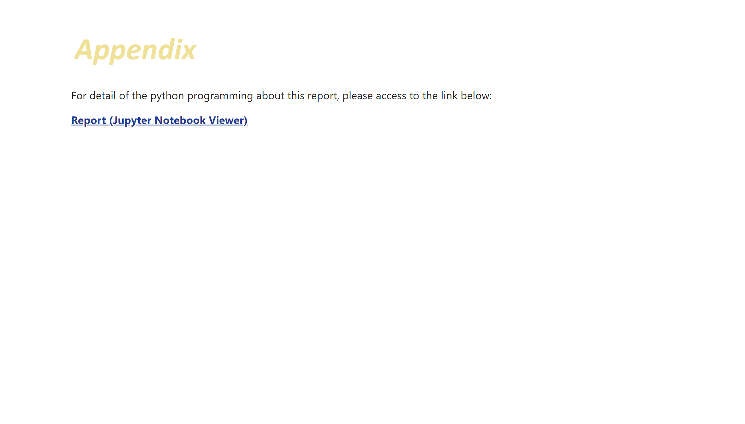
Appendix
Notes:
textbox
No alt text provided
textbox
No alt text provided

Slide 33

End
Notes:
textbox
No alt text provided
shape
No alt text provided
shape
No alt text provided

